Slide 1


Building in House Scalable Mobile Device Lab
Sargis Sargsyan

Slide 2

Introduction
Sargis Sargsyan
Director, Quality Assurance at PicsArt

Slide 3
Mobile Test Challenges
Localization
Network
Every language that will be added to the app, will create an obstacle to overcome.
Wi-Fi, mobile networks, roaming, online or offline, with a weak signal etc
Device, Screen Size, OS
fragmentation
Performance
Mobile app tools
More than 24,000 different Android
Due to the limited hardware architecture of mobile devices, success and failure of application in market depends on performance of the app
Which tools to choose for mobile Testing?

Slide 4
Mobile Device Lab
What is the
Device Lab
A mobile device lab is a collection of mobile devices available for testing apps and services.

Slide 5
why we build a device lab?
Ability to Test physical experiences
We have a photo editor app
We create an opportunity to test the app on a physical devices and have testing close to a user scenarios
Lots of functionalities in the app are visual changed that needs to be tested.
Create a custom infrastructure
for automation
Cost Efficient
The solution is cost efficient in the long term
We have freedom to create/edit the infrastructure to have more effective automation suite

Slide 6
Main Achievements with Mobile lab
Use Real Devices
Use a Secure, Private Mobile Device Testing Cloud
Use of emulation/simulation technology, it isn’t the most trustworthy solution for testing. These tests often overlook critical errors and report false defects
Using a secure and private device lab is a crucial for enterprises with a large number of testers. This separation can range anywhere from a different building to another continent. Even when using a testing cloud, it’s important to be high performing and secure.
1
3
Apple Code Signing and Provisioning
Don’t Automate Everything
A common challenge that testers face when creating a mobile device testing lab is iOS provisioning, the process by which Apple allows an app to be installed and launched on a real device.
A solid mobile device testing strategy takes into consideration when to automate and when to fall back on manual testing. The fact remains that some tests are simply faster, easier and less expensive to run manually.
2
4

Slide 7

The Stack we have
Appium
We use Appium for our mobile automation due to its cross-platform nature and basis on the WebDriver protocol
Jenkins
Android & iOS
We run test on both mobile platform
Android & iOS
We use Jenkins to run the test parallel
Java
Selenium Grid
We use Java to write end to end automation tests
We use to have parallel Threads

Slide 8
The Hardware Stack we have
Mac mini
iPhone & Cabling
Powered USB hub
Android Phone and Cabling
Monitors for Reports

Slide 9
Ecosystem
Node 1
Node 2
Node 3
Grid
iPhone
iPhone
iPhone
USB Connection
Node 4
Node 5
Node … N
Selenum Grid
iPod
iPod
iPod

Slide 10
Ecosystem
Node 1
Node 2
Node 3
Grid
Android
Android
Android
USB Connection
Node 4
Node 5
Node … N
Selenum Grid
Android
Android
Android

Slide 11
Power Management
Plugable USB 2.0 High Speed Charging Hub with 60W Power Adapter
*Where to buy this adapter?

Slide 12
Network Management
We use reverse tether.
Android - gnirehtet to reverse the network
iOS - Native USB tethering
*Where to find gnirehtet?

Slide 13


Jenkins pipeline Architecture
Build Binary
Run Tests
Selenium Grid
Device
Device
Device
Device
Device
Device
Device
Generate Report

Slide 14
Actions inside the Node
Setup
Finalize the build
Run Appium server, Run gnirehtet service, Run mock server (this is app specific service)
Stash report file, stash crash report info and failure screenshots. Send the data to master Node
Clean up
Running Tests
Generate Report
Reboot device, Killing the previews Appium server if still running, Killing gnirehtet if running (Android only),
Running group of the tests
Generate Allure report and publish the HTML

Slide 15
Get into reporting
How did we customized the reporting

Slide 16
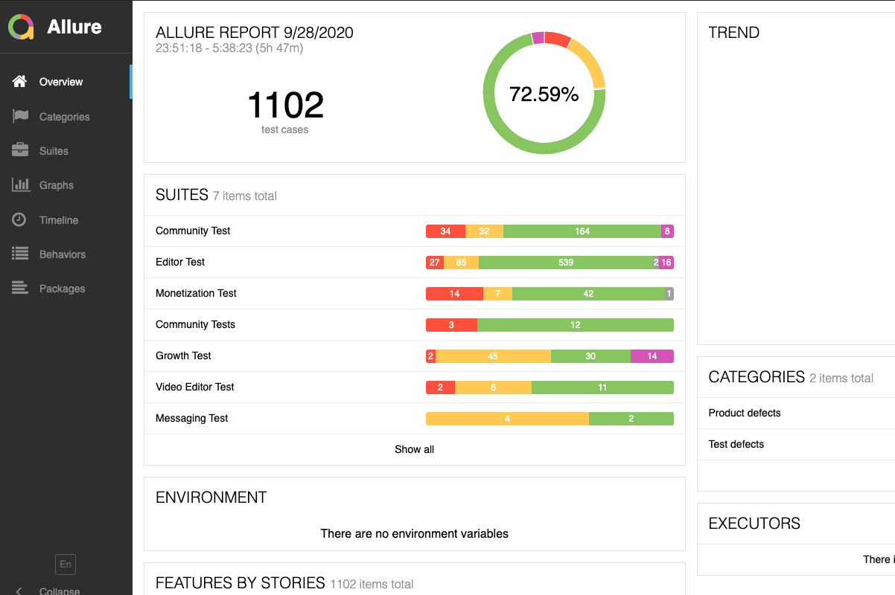
Allure Report
Customizing report
With Allure Report
Allure Framework is a flexible lightweight multi-language test report tool that not only shows a very concise representation of what have been tested in a neat web report form, but allows everyone participating in the development process to extract maximum of useful information from everyday execution of tests.
*Link to Allure Report?

Slide 17
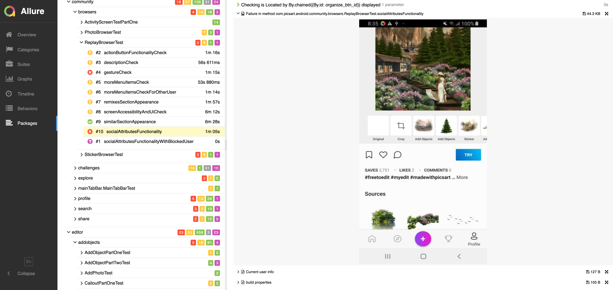
Allure Report

Slide 18
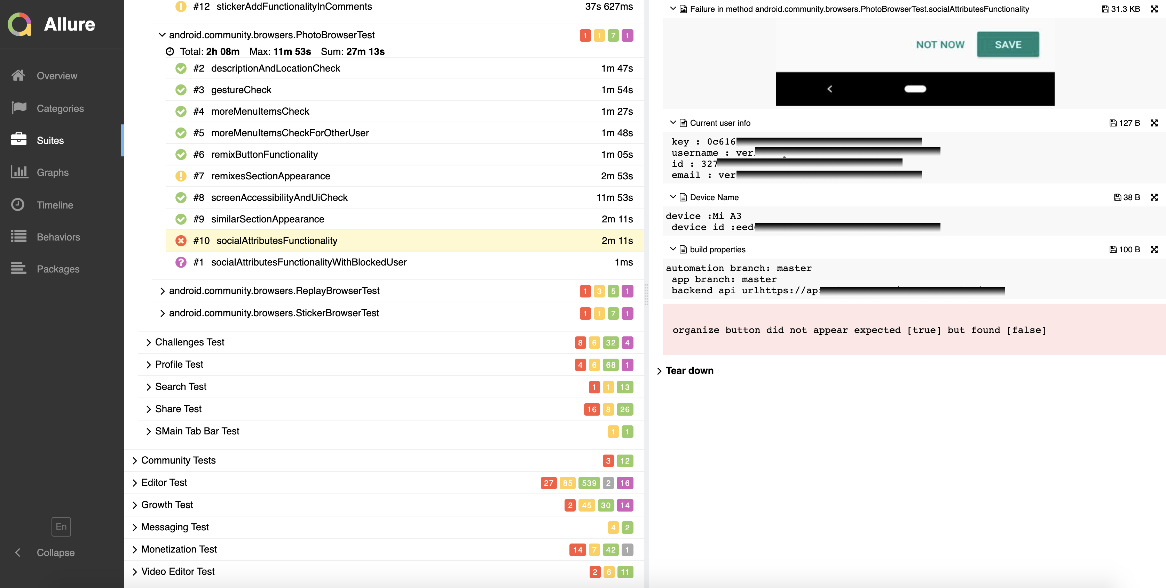
Allure Report

Slide 19
Physical Device lab

Slide 20
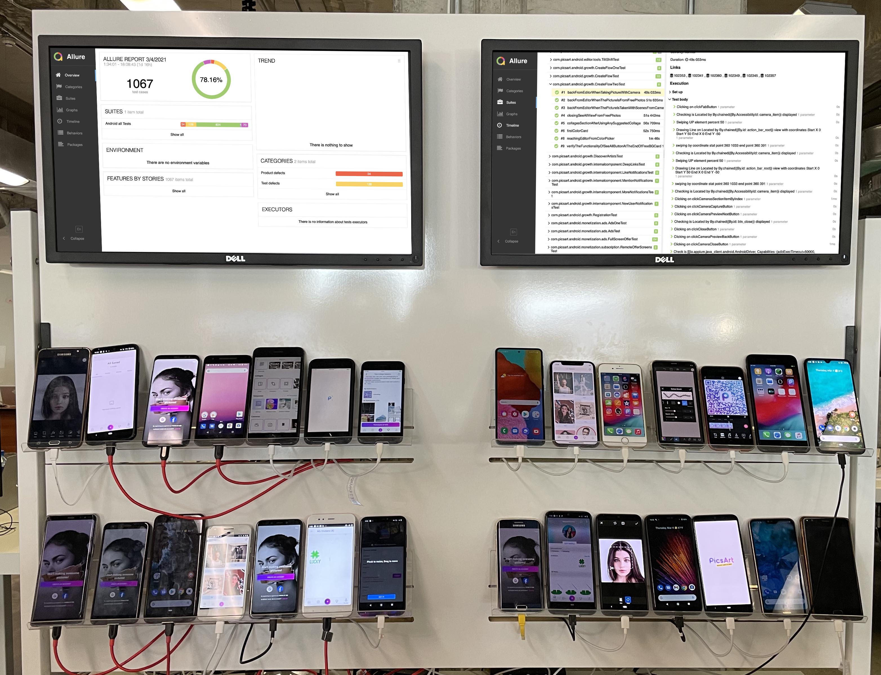
Physical Device lab

Slide 21
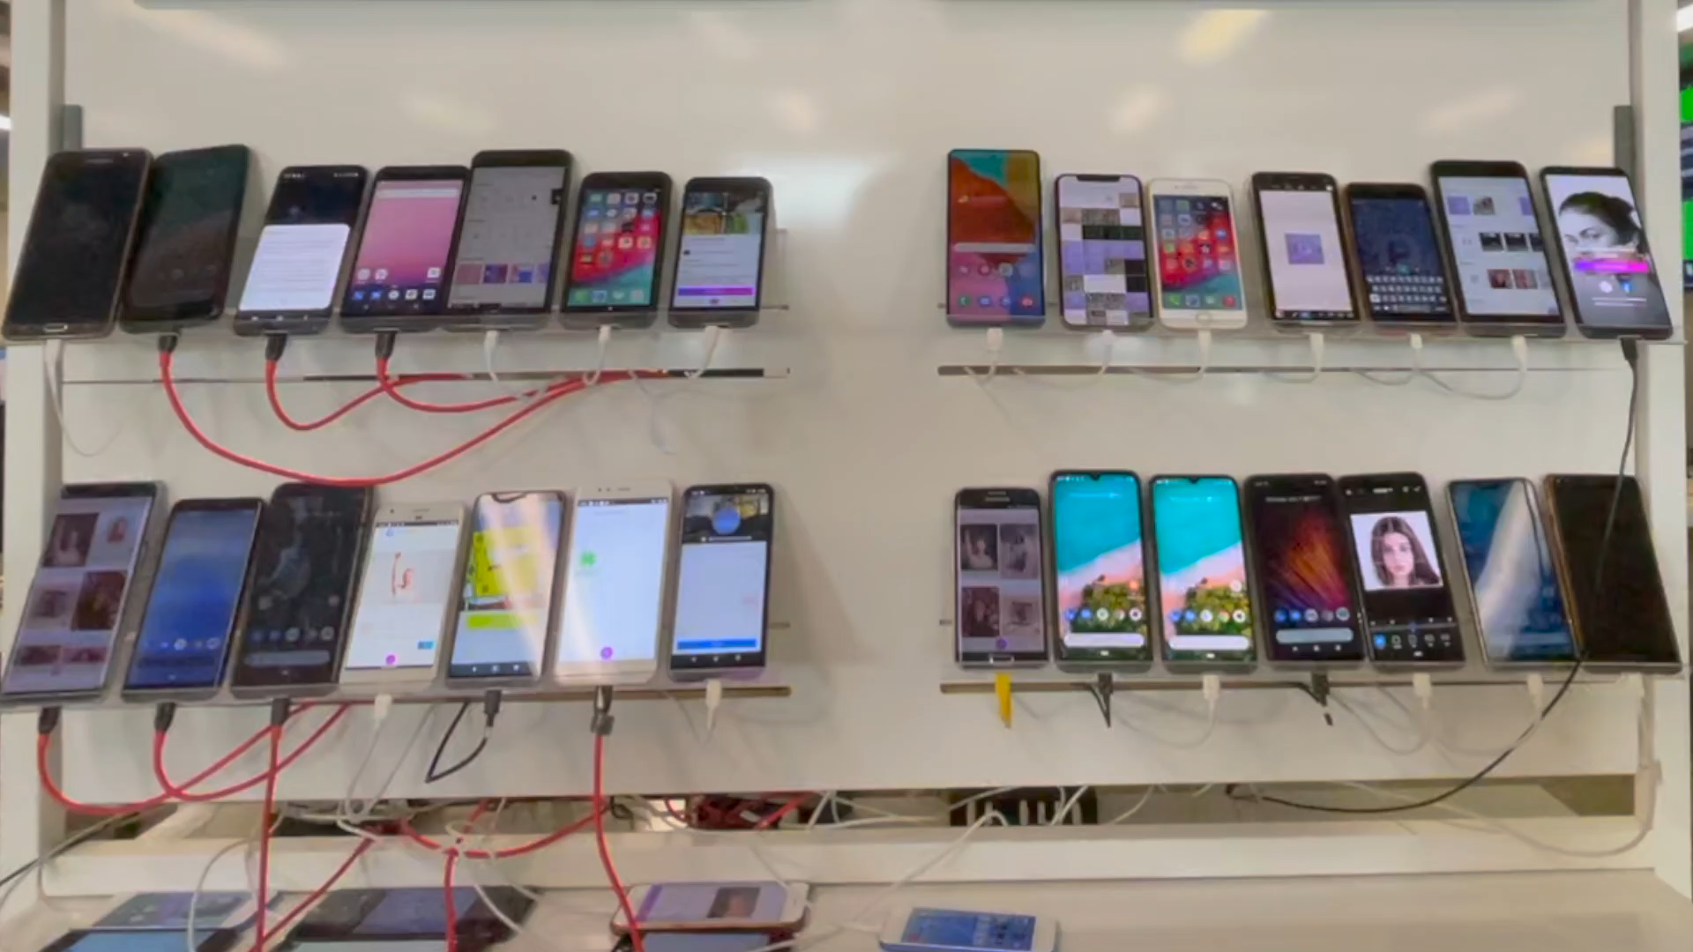
Physical Device lab

Slide 22
Thank You
sargis.sargsyan@live.com
https://twitter.com/sargiset
https://www.linkedin.com/in/sargissargsyan/

