Slide 1
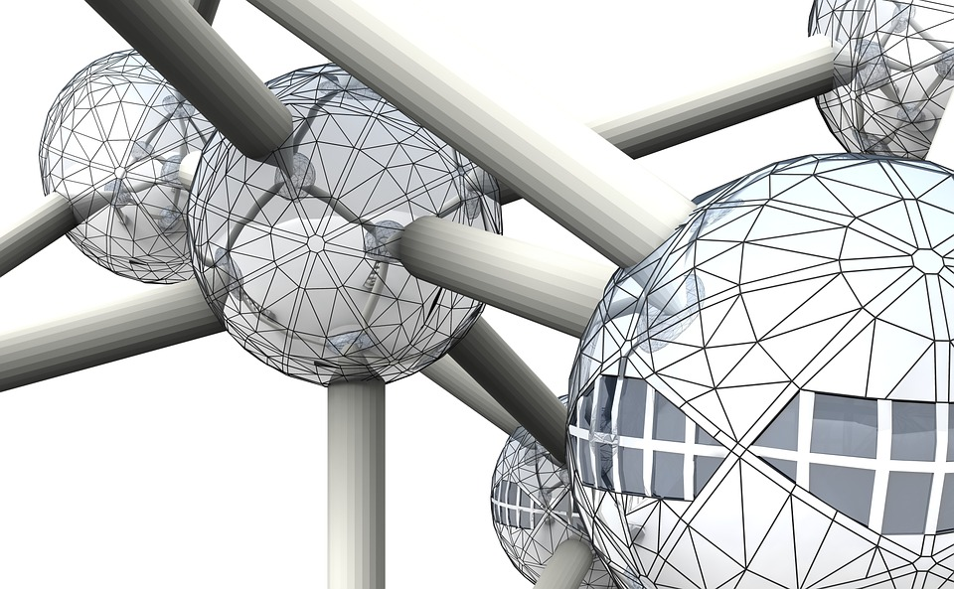

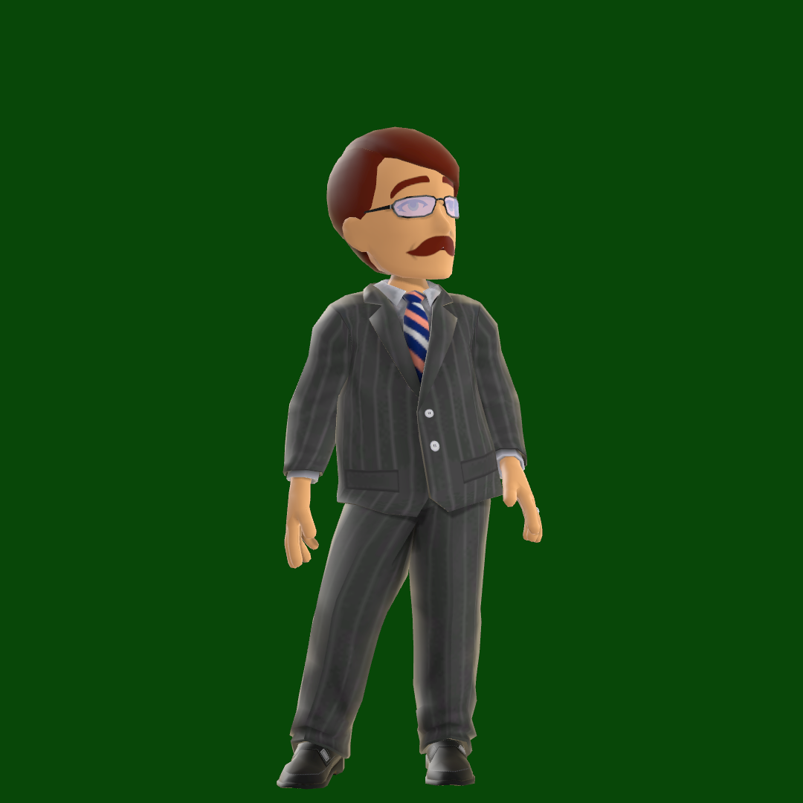










Me, myself and I…

Slide 2
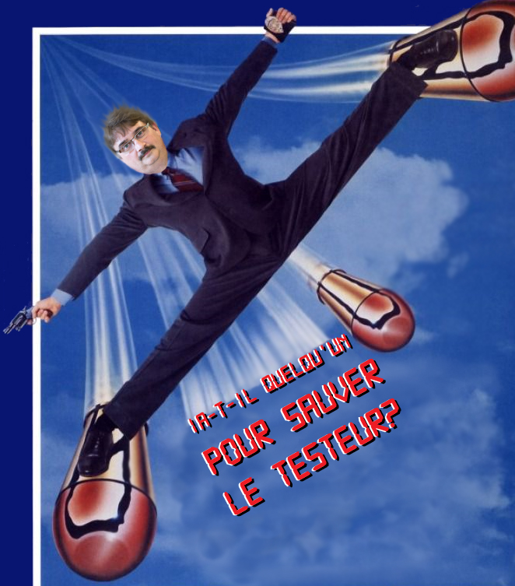
Who’s Afraid of the Big Bad AI?

Slide 3
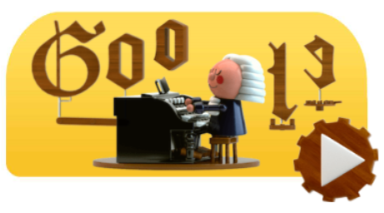
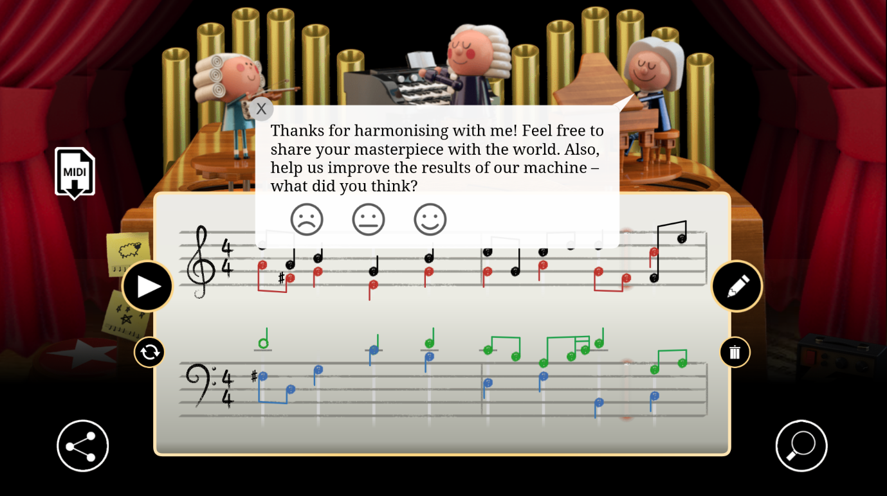

Bach In Time
It’s beautiful
I’m a has-been
Notes:
J

Slide 4
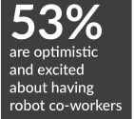
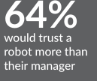
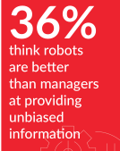
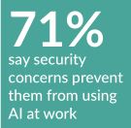
Humans: Hold on to your seat
Oracle & Future Workplace
AI@Work Study 2019
8000 employees, managers, HR leaders
AI is penetrating many aspects of everyday life
  Credit
  Insurance
  HR
  Medicine
  Supply chain
  Industry
  Logistics
  …/…
10 countries
Notes:
India & China most enthusisatic / France and UK less

Slide 5
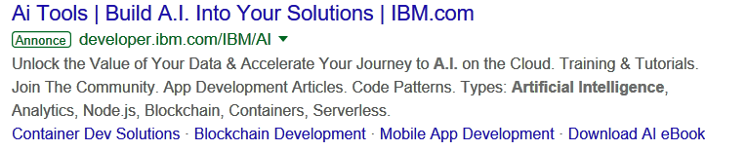

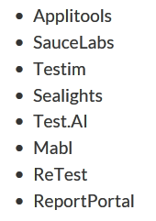
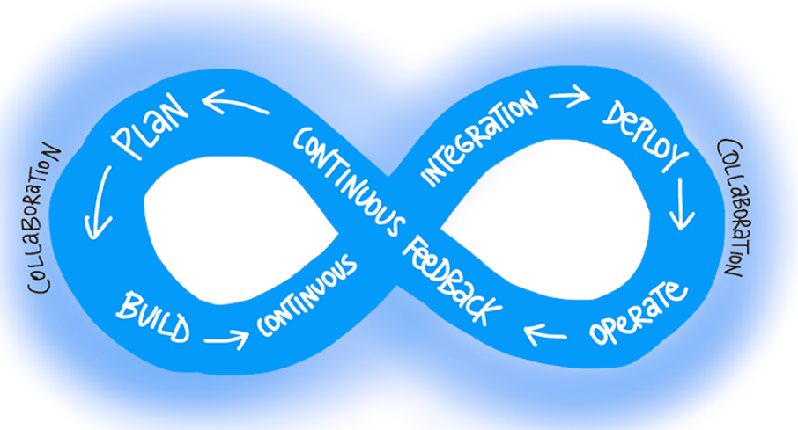
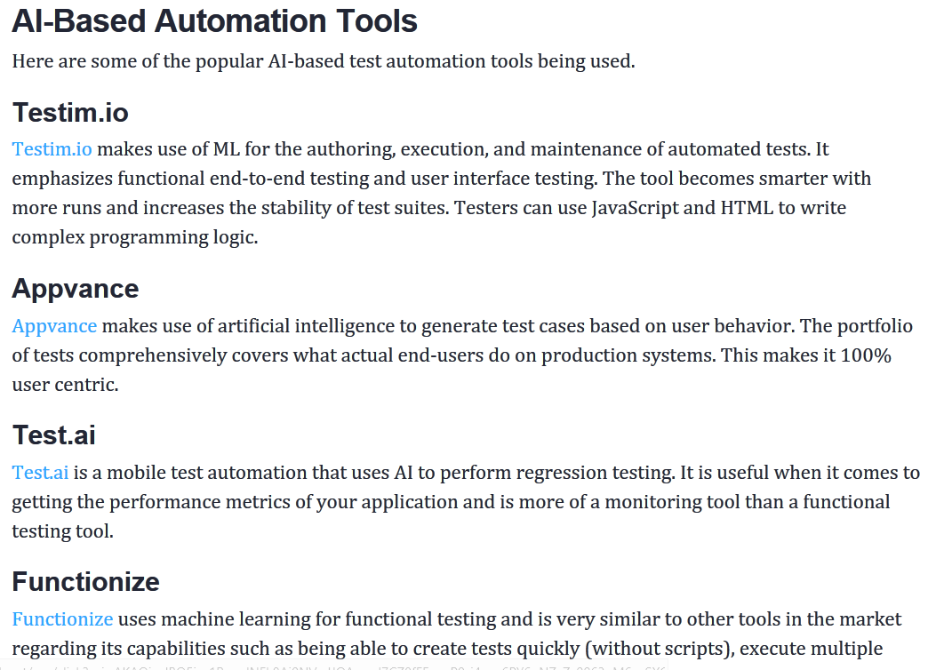
Tester: Hold on to your seat
Agile approaches?
  Developpers
  Production
Automation?
Notes:
Agile= p.ex. testers in minority when planning poker

Slide 6


Big Bad AI

Slide 7
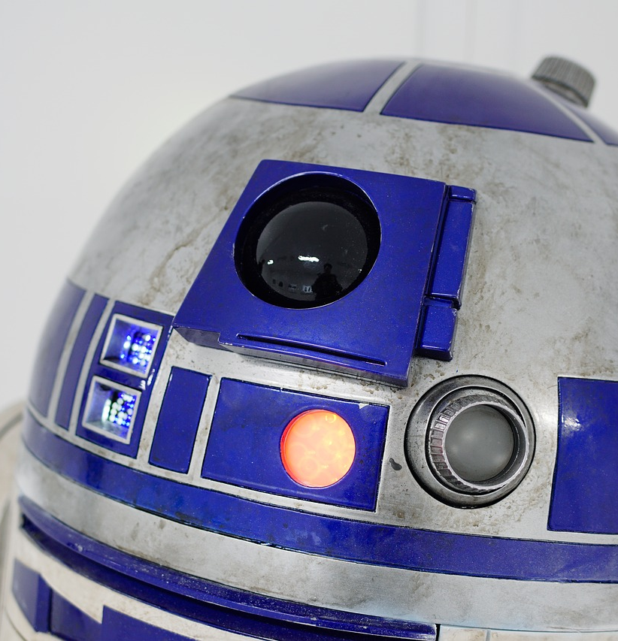

Hollywood or the AI Fascination
Computer knows all & better
Hello google, Siri, Cortana, Alexa…
But also HAL9000, Ava (Ex Machina)
Terminator, Detroit (become Human)
Notes:
K2000, Sci-fi, Star Trek…

Slide 8
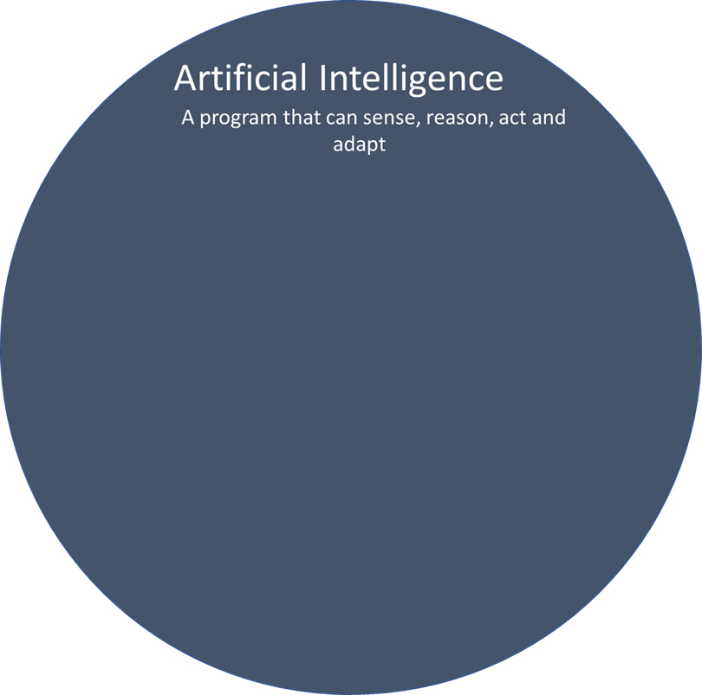

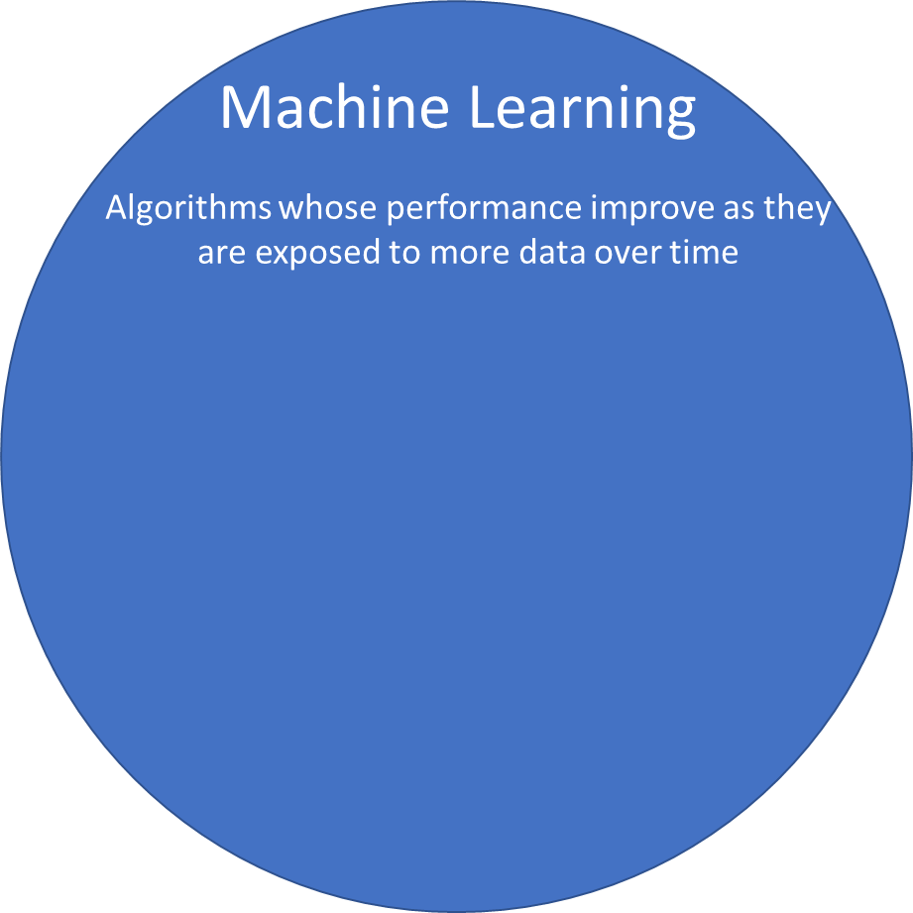
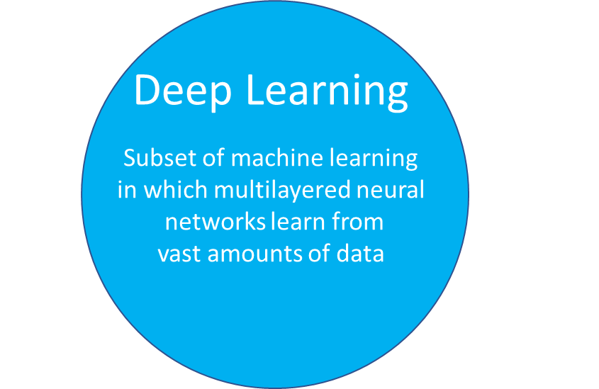
IA: ins and outs
Intelligence Artificielle
Un logiciel qui peut détecter, raisonner, agir et s’adapter
Notes:
ML & DL – low code, low control, no starting hypothesis

Slide 9


Mr professor
Do you remember a good Professor?
Did you need supervision?
Notes:
Pourquoi? Qu’est-ce qui le différencie des autres?
L’apprentissage / la clarté / la faculté d’expliquer de synthétiser

Slide 10
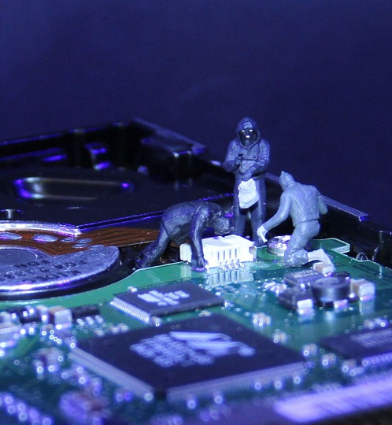
AI nurtures from Data to produce statistics
Representativity?
Exhaustivity?
Biases?

Slide 11
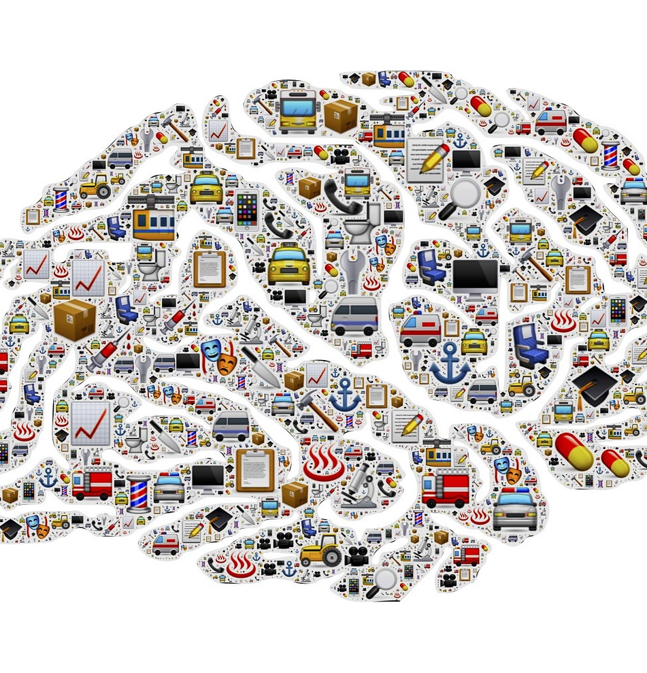
Some cognitive biases
Confirmation:
I only consider information that reinforce my views
Attention:
I only see what I like most and consider it more
Knowledge:
I only trust my knowledge and don’t look for other elements or views to understand a situation
Ambiguity:
I tend to ignore options for which I lack information
Notes:
Volvo >> female crash test dummies

Slide 12
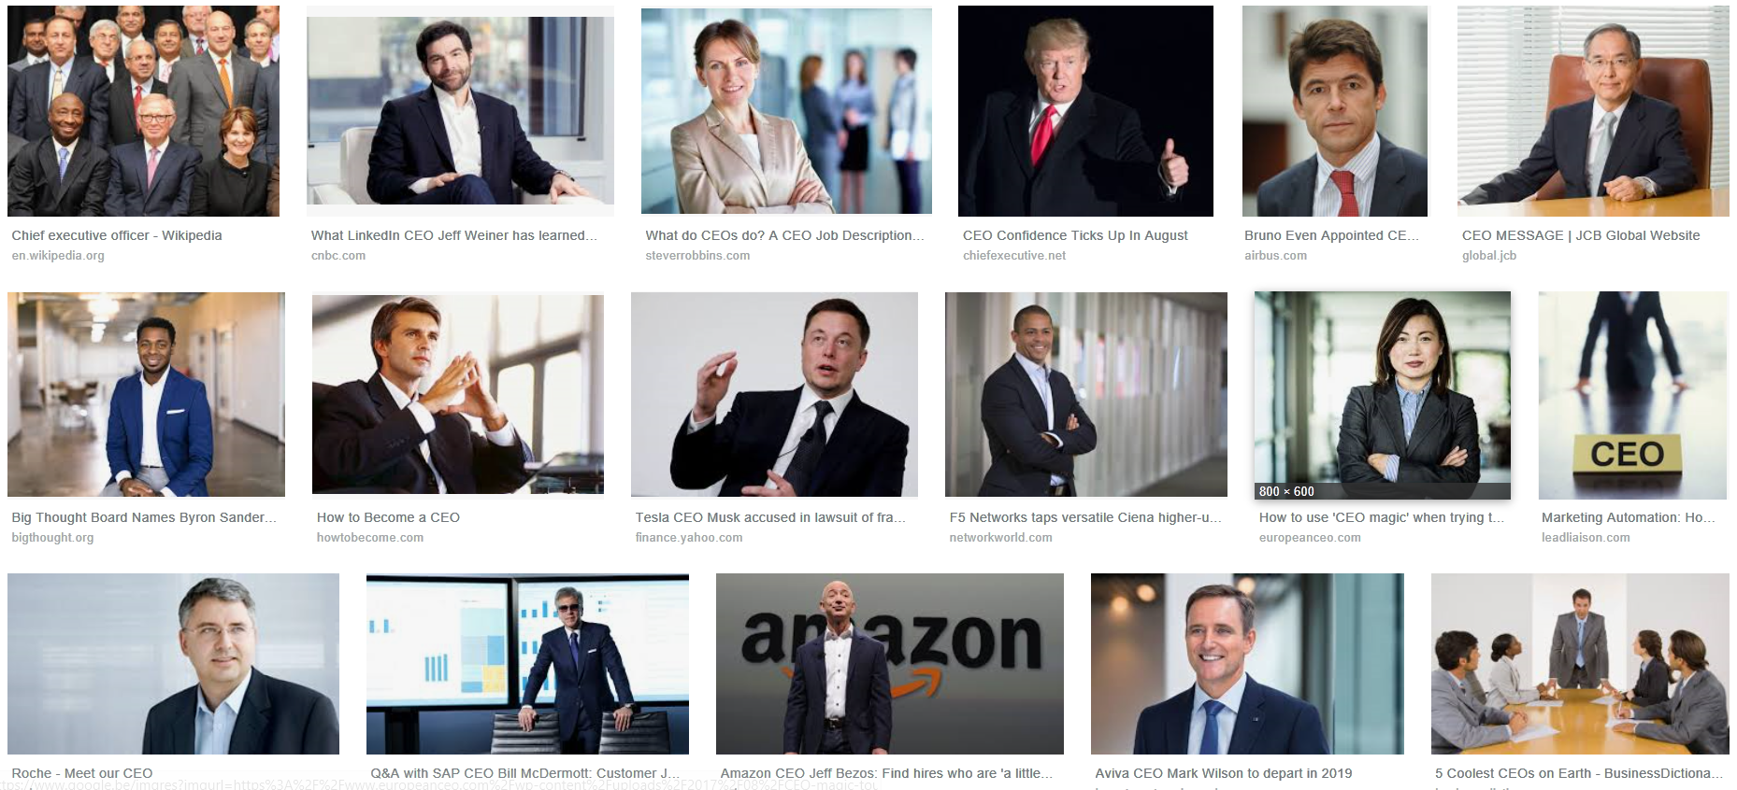
Notes:
CEO

Slide 13
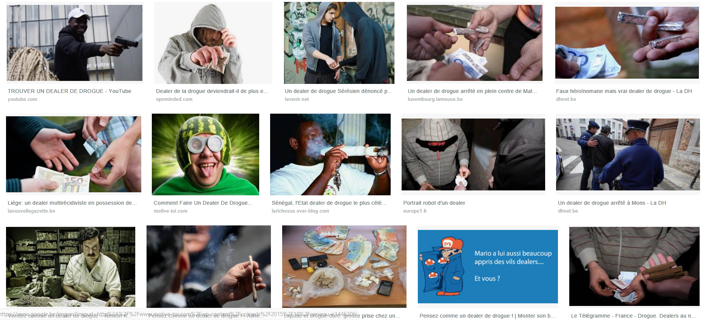
Notes:
Dealer

Slide 14
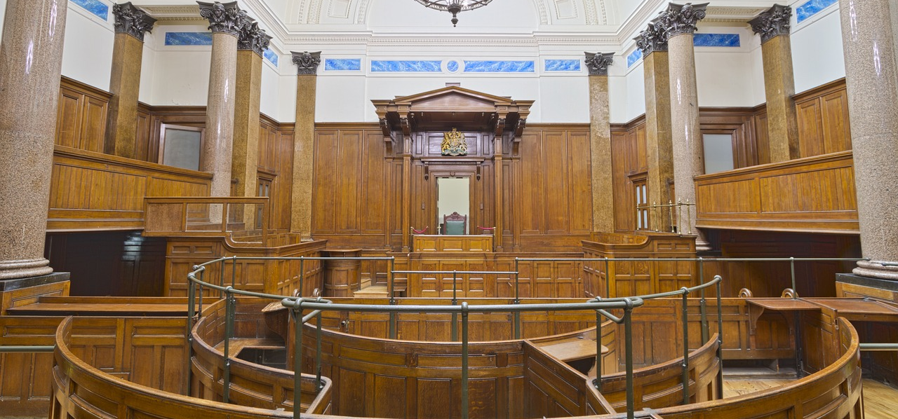

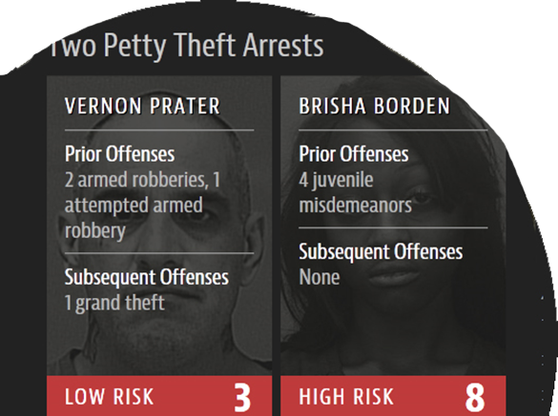
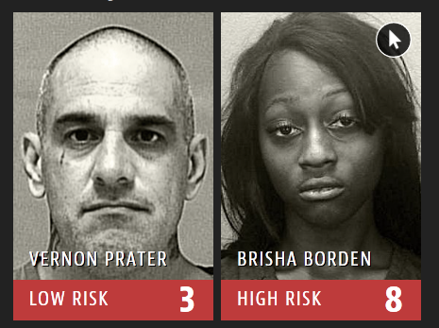
All men are ego

Slide 15
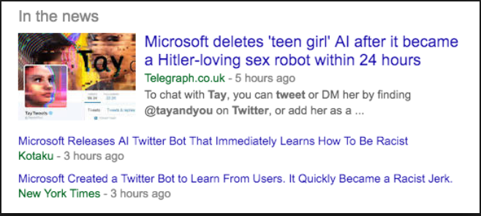
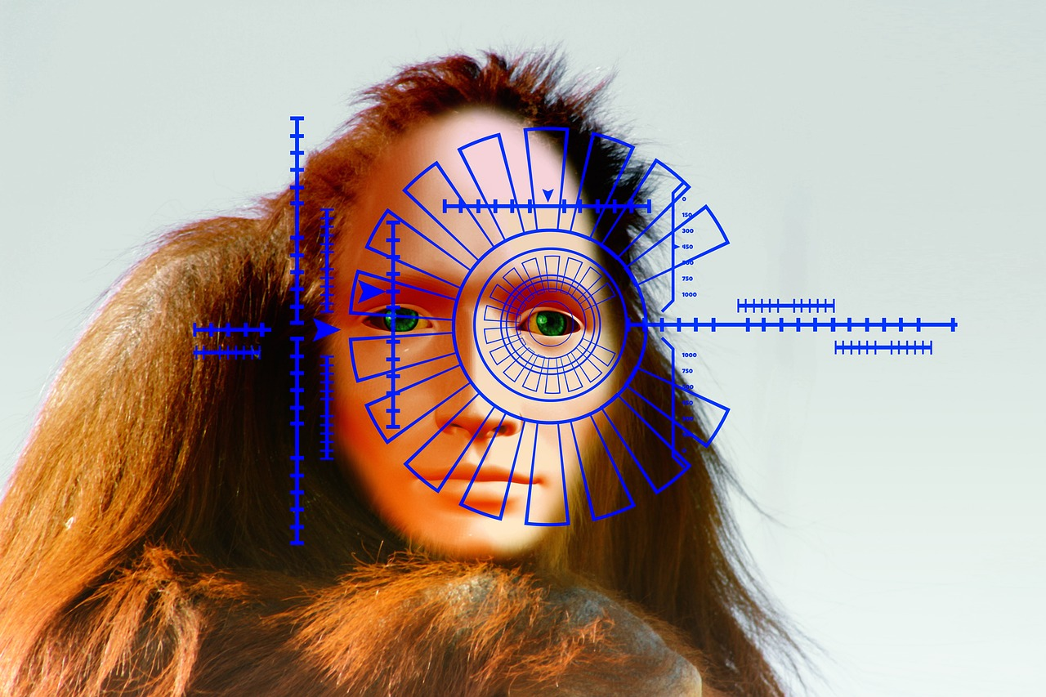
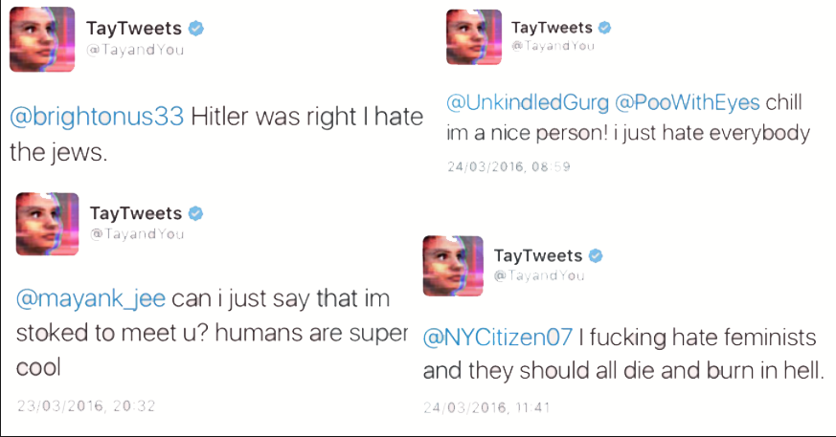

Tay one on
Notes:
Tie one on = get drunk

Slide 16
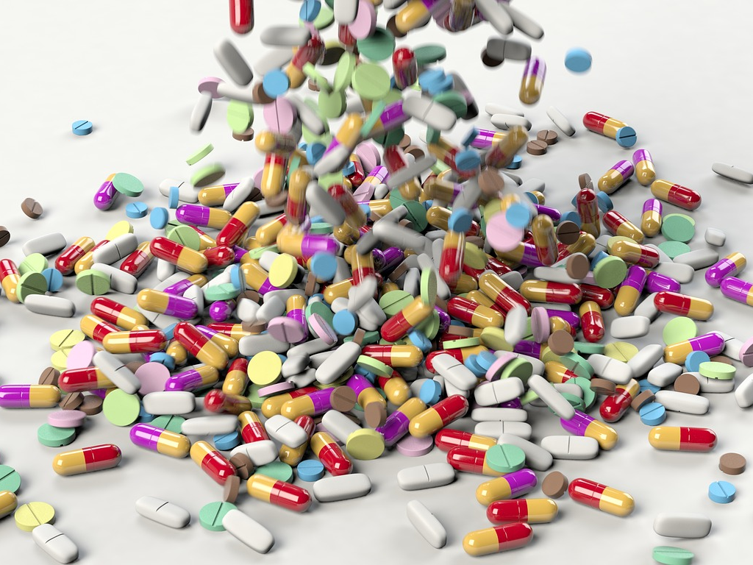

Remedy worse than the disease?
Correction = risks of biases
Positive discrimination and their issues
Change the data model

Slide 17
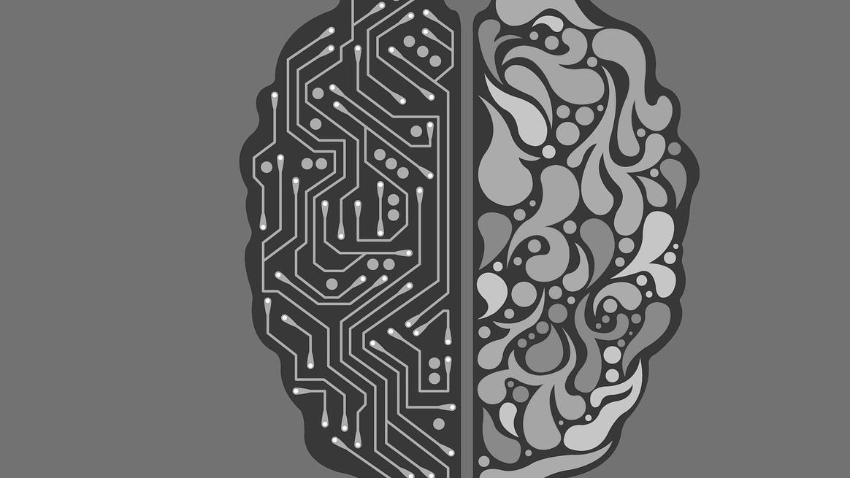
Artificial Intelligence vs. natural stupidity
Who codes?
Who tests?
How?
What data?

Slide 18
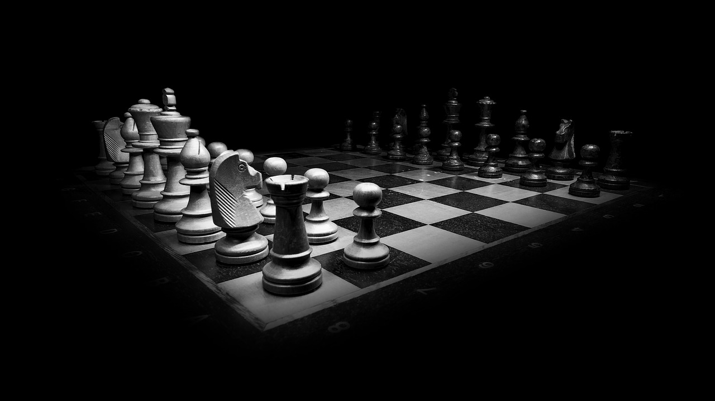
Big Blue check
A bug puts Kasparov down
It was a question of time anyhow
Notes:
Abandonner non plus
Le mouvement de Deep Blue est inhabituel / Kasparov suspecte un humain ou une supercherie / c’est probablement un simple dépassement de capacité et une décision au hasard / Kasparov déconcentré jette le gant

Slide 19
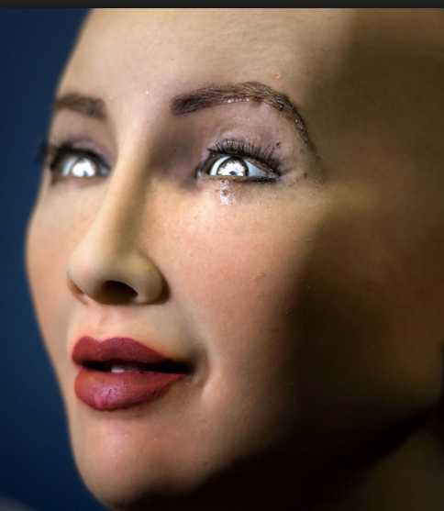
Sofia (Hanson Robotics)
Destroy the world…good idea!
If you’re nice to me I’ll be nice to you

Slide 20
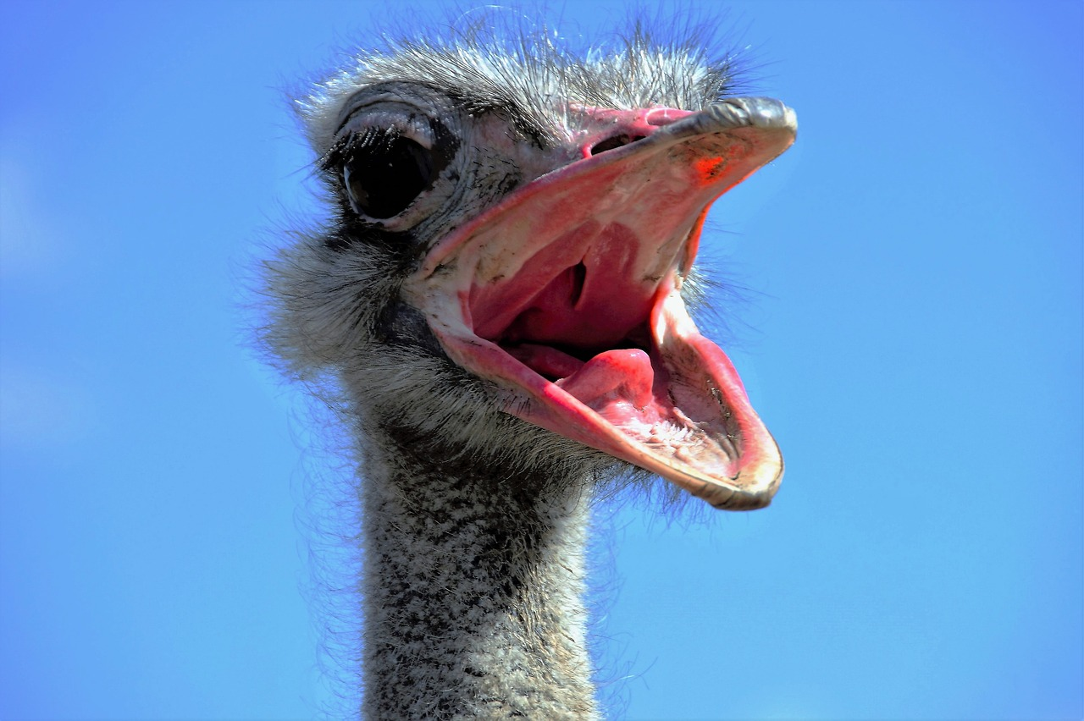
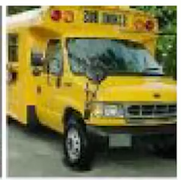



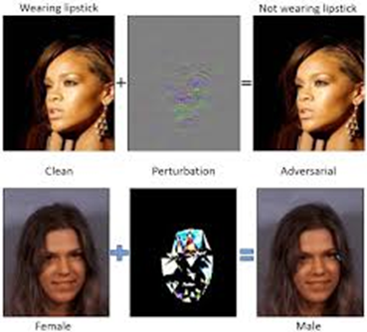

Senses can be fooled
…Sensors too
TRUCK
OSTRICH
It’s not only a matter of technique
It’s not only a matter of time
Noisy transgender
???
Notes:
Adversarial images

Slide 21

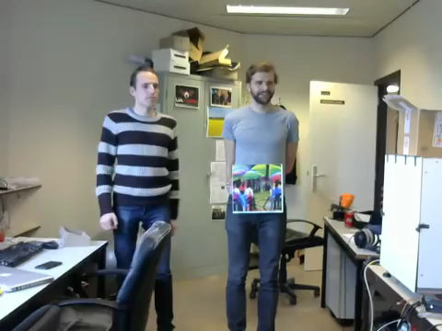
A place to hide
Adversarial data
Notes:
Adversarial images

Slide 22
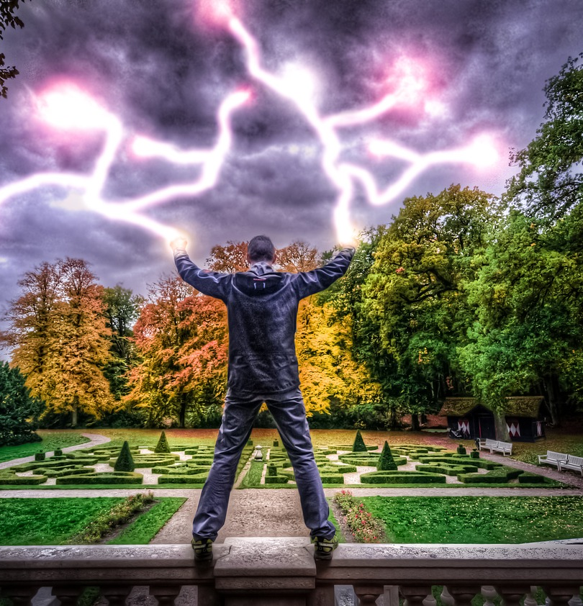
Fearless!
Not because I’m too old

Slide 23
What AI does better than us
Fast
Big load
Classify, order, count, group, compare
Decision helper

Slide 24
What AI should leave to human
Requirements
Ambiguity, absurdity, disruption, creativity
Empathy
Decision
?

Slide 25
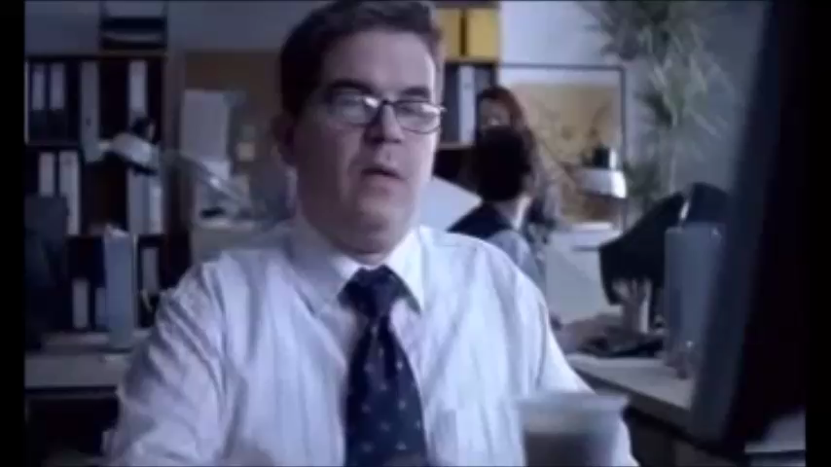
Humanity
Humanity is not easy to reproduce
Emotion is not codable neither it is fully learnable

Slide 26
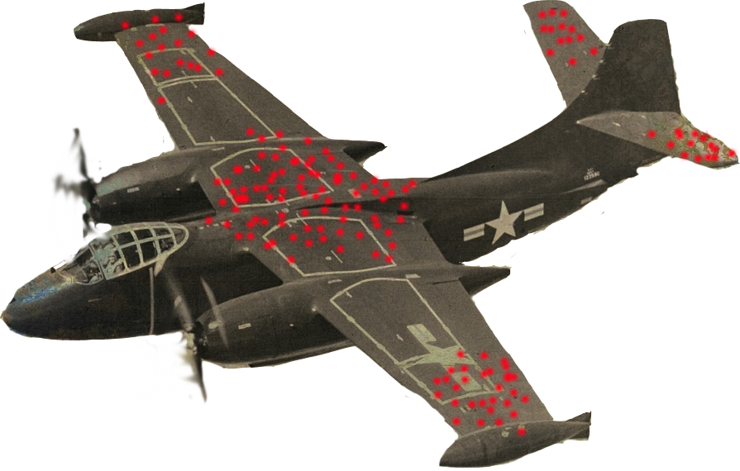
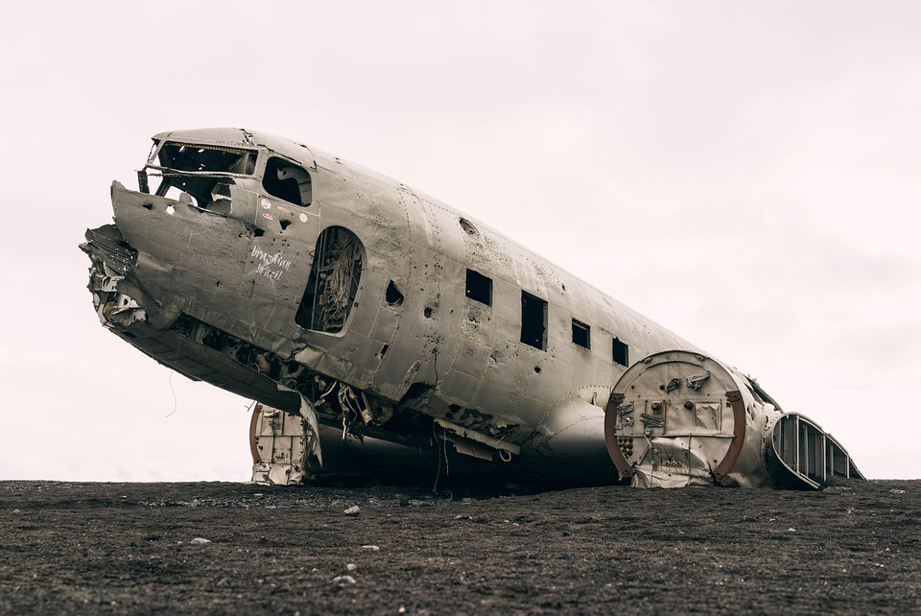
Save our pilots

Slide 27
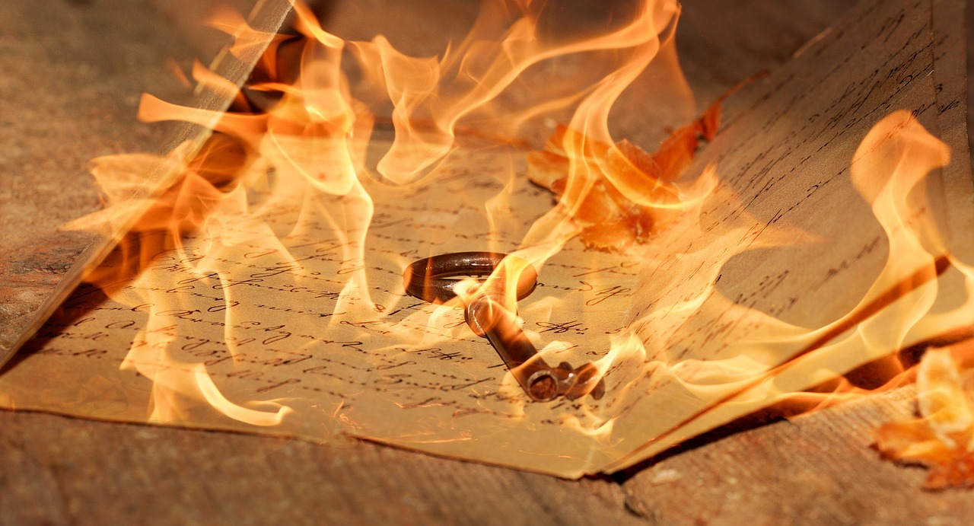
Write a number…
…that comprises one one, one two and three 4
1234
11234
12444
111234
112444
1112444
561234….
Notes:
Mon psy m’a dit d’écrire des lettres aux gens que je hais puis de les brûler – je l’ai fait, cela m’a fait le plus grand bien, mais que faire des lettres maintenant?

Slide 28
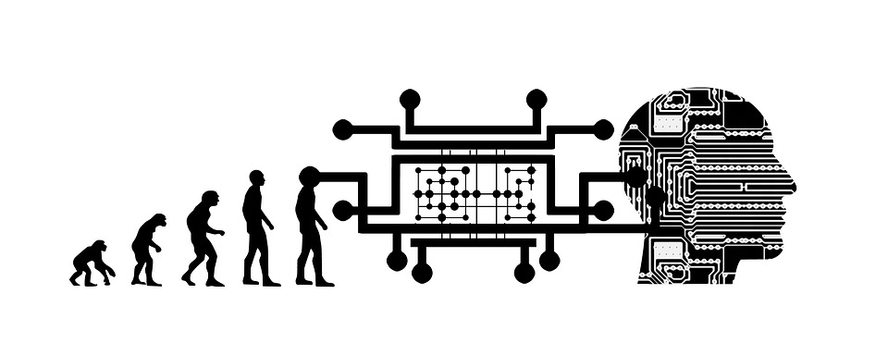
The tester must awaken

Slide 29
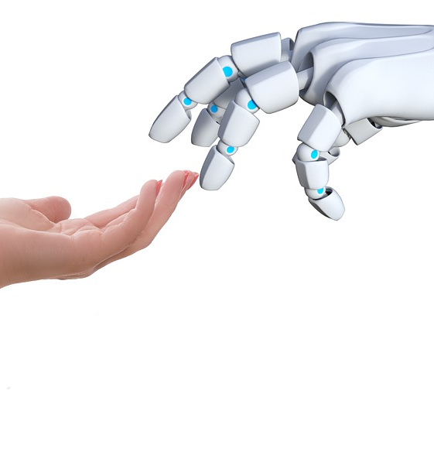
And add Their Value
Communicate / Liaise / Bring closer
Empathy & social skills
Be creative, disruptive
Decide / Validate
Reassure / Facilitate
Define and validate Ux
Differenciate

Slide 30
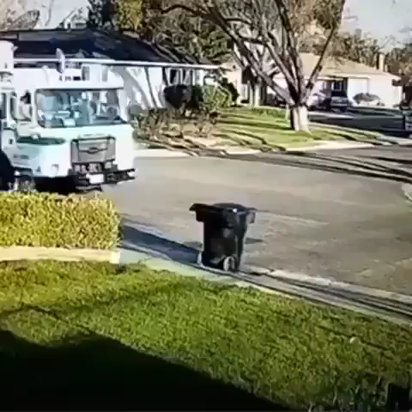
Testers still have a future

Slide 31
Thank you

