Slide 1
The Continuous Testing with TOSCA
Ismail Çelik
Minsk, 26.05.2018

Slide 2

  SOftware, Testing SOlutions & Services
        Software Solution Engineering Company with Headquarter in Zurich, Switzerland
              Operational Center based in St. Petersburg, Russia
Certified Implementation Partner of TRICENTIS
                Software End 2 End Solutions
Principe of Software Engineering in Testing
Agile Developments Methods

Slide 3
Future of Testing
Continuous Testing Is A Must
Fast Feedback To The Impact Of Change.
If You Want To Transform to DevOps.
Do The Right Things & Do Things Right
Develop The Least Amount Of Test Cases. Cover The Maximum Amount Of Business Risk.
Stop Chasing Test Coverage. Reduce Redundancy.
Start Chasing Risk Coverage.
Manual Testers Become Automation Specialists
Empower Everybody To Build Complex, Powerful, Script-free, Business-Readable Automation.
1 Automation Expert supports 10 Manual Testers move towards Automation.

Slide 4





















The Continuous Testing Company
Worldwide Operations
400+
Automated Continuous Testing solutions that deliver a
10x improvement
over traditional software testing.
Austria (HQ) USA (HQ)
Australia
India
The Netherlands
Germany
Switzerland
Poland
UK
Blue Chip Customer Base
95%
renewal rates
Strong Financial Performance
84%
New license bookings
2017 Growth:

Slide 5

Rise of DevOps Demands a New Testing Paradigm
Old Paradigm:
(Waterfall)
Analyze
Plan
Design
Build
Test
Deploy
81% of enterprises have adopted or plan to adopt DevOps.
RELEASE
CODE
Radical increase in velocity and iteration
Focus on quality, flexibility and automation
Old manual and script-based testing framework is a major bottleneck
Today:
(Agile and DevOps)
PLAN
DEPLOY
Dev
Ops
CONTINUOUS TESTING
OPERATE
BUILD
MONITOR

Slide 6


Today
The reliance on manual testing is the
#1 technical challenge in app development¹.
> 80%
Manual Testing
$32B
Annual Spend on Testing Services
< 20%
Automated Testing
UI
Legacy platforms require weeks to execute testing. Test automation requires developers.
API
1 … Source: World Quality Report 2015 - 2016

Slide 7


Today
Tomorrow
Exploratory Tests
Automated UI Tests
Automation is a must.
Automation doesn’t make testing easy, it makes testing possible.
80%
Manual Testing
+85%
API Tests
20%
Automated Testing
UI
Orchestrated Service Virtualization
API
- key enabler for high automation rates -
Testing Future

Slide 8



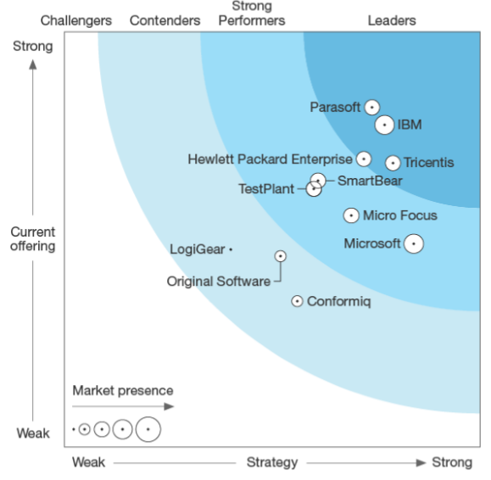
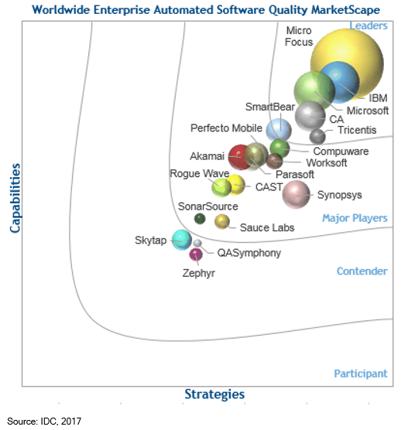
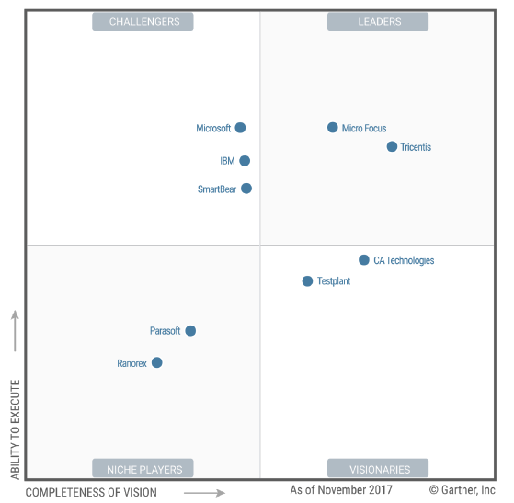
Leadership
“Comprehensive set of capabilities for testing modern applications on both the UI and API layer for a wide range of enterprise applications”
Gartner

Slide 9



























Visibility and Insight for Greater Velocity
Continuous Testing Platform
Explore
Optimize & Manage
Automate
Exploratory
Testing
Risk-based
Testing
Test Data
Management
Service
Virtualization
Test
Automation
Load Testing
Integration / DevOps Toolchain
End-to-End Functional & Load Testing
XCode
Notes:
Main point here is how do you do it and how is it different or better
Risk
e2e
Enterprise CT
Optimize
Test case design
TDM
Functional BI, SAP,
Design
Optimize RBT
Redundancy
TDM (synthetic, TD,
MBTA
SV
Exploratory (usabil,UAT
Load

Slide 10


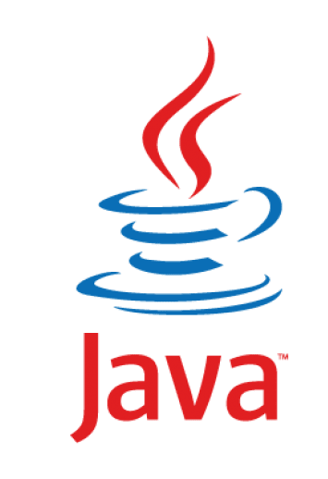




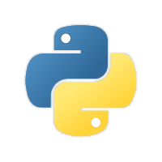




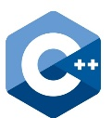


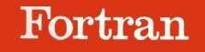

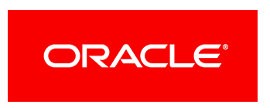









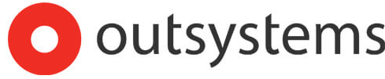
Visibility and Insight for Greater Velocity
Continuous Testing Platform
Explore
Optimize & Manage
Automate
Exploratory
Testing
Risk-based
Testing
Test Data
Management
Service
Virtualization
Test
Automation
Load Testing
Technology / Application Support
RPG
Notes:
Main point here is how do you do it and how is it different or better
Risk
e2e
Enterprise CT
Optimize
Test case design
TDM
Functional BI, SAP,
Design
Optimize RBT
Redundancy
TDM (synthetic, TD,
MBTA
SV
Exploratory (usabil,UAT
Load

Slide 11
Visibility and Insight for Greater Velocity
Continuous Testing Platform
Explore
Optimize & Manage
Automate
Exploratory
Testing
Risk-based
Testing
Test Data
Management
Service
Virtualization
Test
Automation
Load Testing
End-to-End Functional & Load Testing
2X
Risk Coverage
2-3X
Release Speed
30-40%
Cost Reduction
10X
Compared to other testing tools
Notes:
Main point here is how do you do it and how is it different or better
Risk
e2e
Enterprise CT
Optimize
Test case design
TDM
Functional BI, SAP,
Design
Optimize RBT
Redundancy
TDM (synthetic, TD,
MBTA
SV
Exploratory (usabil,UAT
Load

Slide 12
How Continuous Is Your Testing ?

Slide 13







Plan
Code
Version
Build
Provision
Test
Deploy
Report
Tosca DEX
Tosca CI
XCode
MS Insights
integration test results
unit test results
Integrate
Prioritize
Design
Integrate
Explore
Manage
Integrate
Virtualize
Automate
Configure
Integrate
Distribute
Execute
Integrate
Report
Monitor
Diagnose
Tosca
Connect
Tosca
Diagnostics
Tricentis Delivery Pipeline

Slide 14







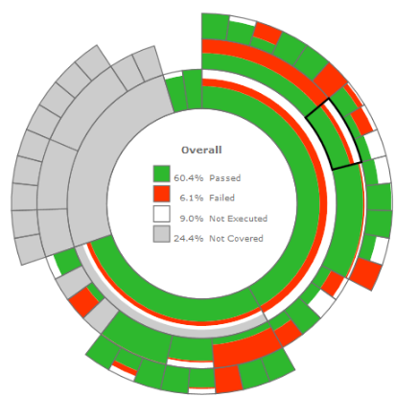























PLAN
CODE
BUILD
CONTINUOUS TESTING
DEPLOY
MONITOR
XCode
Report KPI’s:
Power of the Set
Coverage
Execution-State
Tricentis Tosca
AGILE: Creation of TestCases while Development.
ToscaCI
TCD for logical TestCases.
Early scanning of UI on DEV level
TD-Management for runtime Data.
API-Tests when possible.
ToscaCI
DEX
Report Results:
PDF
Excel
XML
HTML
Server
Executable TestCases for each Stage Development, Sys-Integration, E2E-Test.
ToscaCI
Create
Tosca Requirements in early stages for Test-planning.
…
…
Distributed Execution with
“Tricentis Tosca DEX”
on multiple machines in parallel, with UI & NonUI TestCases at the same time.
Build-Server [Linux & Windows Server] build the Code, deploy it, and Test-Execution is triggered through Tosca Continuous Integration (ToscaCI).
Synchronize:
Defects
TestCases
Execution-Results
with Custom Tosca/ALM Integration
Customization
Over 370 Custom Controls for over 100 Applications versioned in SVN.
Real World Scenario: Tier 1 Global Bank

Slide 15
Can You Scale At Speed?

Slide 16
Model-based tests are
reusable and maintainable
without technical expertise

Slide 17










Logical Name
Value
Action
Technical Name
Value Range
Create Vehicle Insurance
Enter Vehicle Data
Vehicle Data
Make
Audi
Input
Make
-
Scan Application….
Engine Performance [kW]
200
Input
Engine Performance [kW]
-
Year of Construction
{Year}
Input
Year of Construction
2015;2014;2013;2012
Number of Seats
5
Input
Number of Seats
1;2;3;4;5;6;7;8;9
Fuel
Petrol
Input
Fuel
Petrol;Diesel;Gas;Other
List Price [$]
35.000
Input
List Price [$]
-
License Plate Number
B-CD 123
Input
License Plate Number
-
Usage
Private
Input
Usage
Private;Commercial
Annual Mileage
10.000
Input
Annual Mileage
-
Next
{CLICK}
Input
Next
{CLICK};{RIGHTCLICK}
Enter Insurant Data
Insurant Data
Enter Product Data
Product Data
Start Date
01/03/2016
Input
Start Date
01/03/2016;01/04/2016
Insurance Sum [$]
7Mio
Input
Insurance Sum [$]
3Mio;7Mio;10Mio;15Mio
Payment Option
Yearly
Input
Payment Option
Yearly;Quarterly;Monthly
Next
{CLICK}
Input
Next
{CLICK}
Verify Quote Details
Quote Details
Price List
Select
Insurance Sum
Select
It’s like playing Lego.
Gross Premium [$]
1.535,22
Verify
Business Information
Technical Information
Models And More

Slide 18
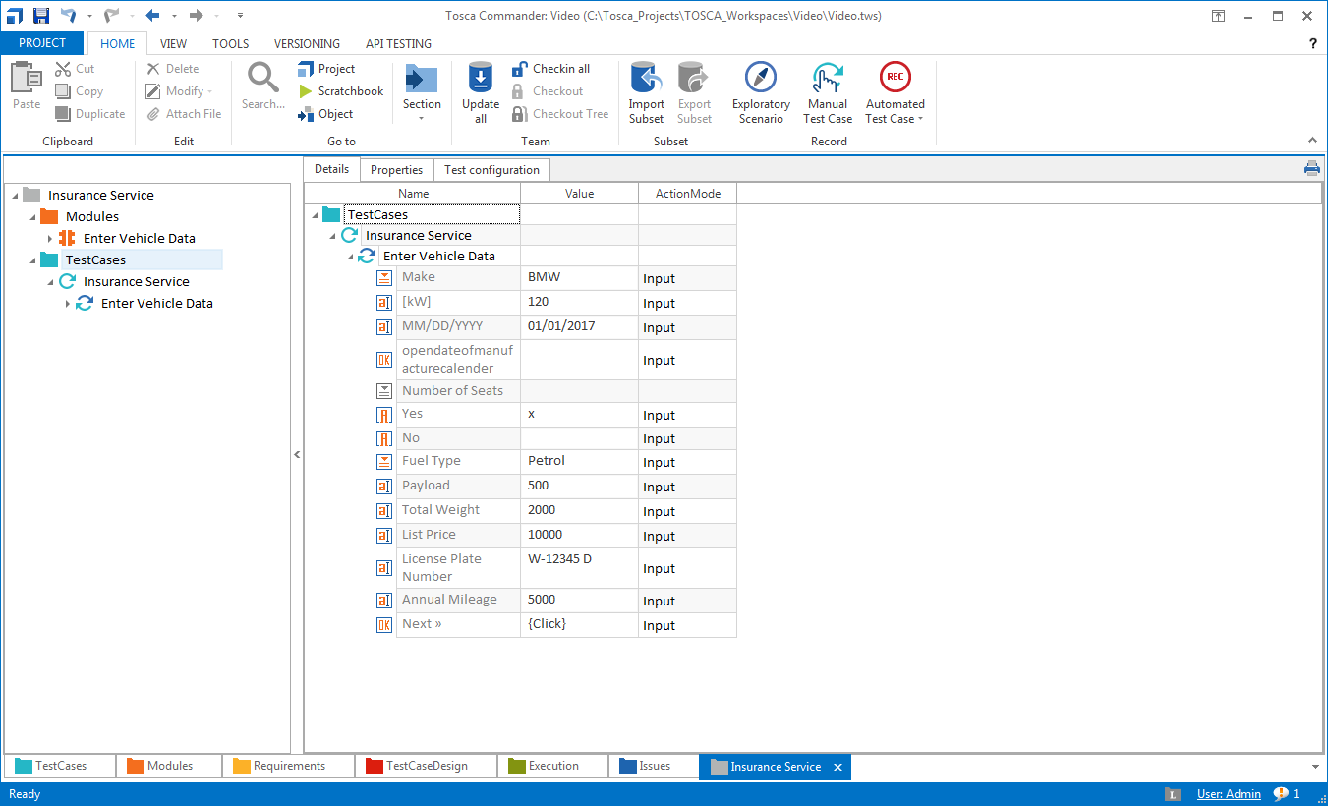
Tosca Business Readable UI Test Case

Slide 19
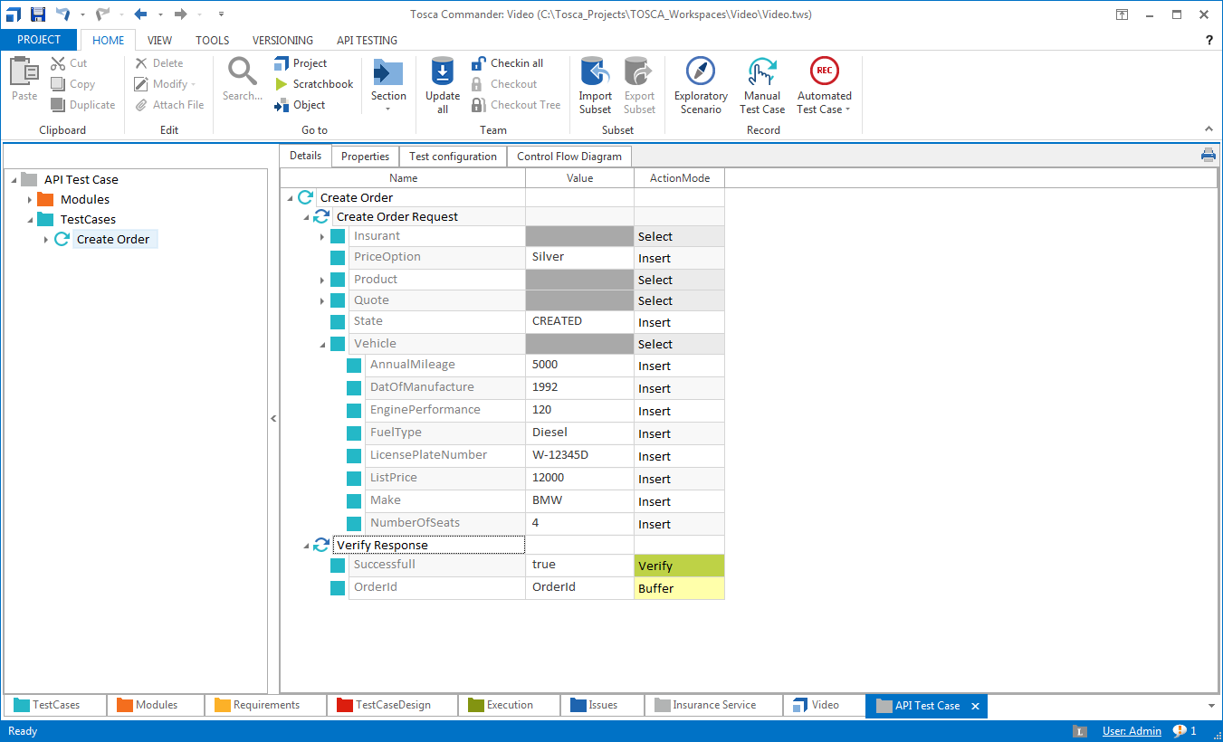
Tosca Business Readable API Test Case

Slide 20

Real World Example
Test Cases
Risk Coverage
Run Time
Australian Bank
Start
2200
30%
8 Weeks
Optimize
85%
2 Weeks
Incl. TdM
600
5 Weeks
value-based
Test Cases
Automate
87%
1 Hours
2 Days
model-based test
Automation
automation level
smoke testing
regression testing
Integrate
12 Mins
< 3 Hours
Continuous
Integration
smoke testing
Continuous regression
Notes:
So let’s close with a real world example. {CLICK}
This is a bank in western Australia. They came to us because they had 2200 test cases, and it took them 8 weeks to perform a manual regression. Their goal was to get this down to under one day to meet their business demands. They estimated that this suite covered about 30% of their risk, but they couldn’t prove it.{CLICK}
We started with a methodology workshop to identify the right test cases. After this effort, we reduced the total number of test cases to 600, and this dropped the manual execution time to 5 weeks. We also were clearly able to identify the risk coverage at 85%. Now, if you are good at math, you are wondering why the total number dropped by almost 75%, but the effort was reduced by less than 40%. Two factors, first, the test cases are longer. More comprehensive, end to end tast case just take more time to run. More importantly, the bulk of the effort in a manual environment is spent in finding and preparing test data. Once we implemented our built in test data management capability, the manual effort was cut to two weeks. {CLICK}
All of this, without automation at all. Once we automated the test case, we achieved an 87% level of automation, and brought the regression down to two days. This was still short of the goal, but we were able to get a quick fix. {CLICK}
Because of our test case design, we were able to segment the full regression into a smoke test that would run in under 1 hour, and save the full regression for periodic builds. But of course we didn’t want to stop there. {CLICK}
By integrating into their CI environment, we were able to kick off a distributed execution and run tests in parallel, bringing the full regression down to under 3 hours. And the best part is, they can maintain it and keep up with new features and requirements.

Slide 21
What else is also important to know?

Slide 22
Support
Training
Professional Services
Educate. Help. Augment.

Slide 23


TOSCA Career paths tied to Heartbeat concept
Test Design Specialist 2
Test Design Specialist 1
Automation Specialist 1
Automation Specialist 2
1 day
(fit for Heartbeat 1)
(fit for Heartbeat 2)
3 days
Automation Engineer 1
3 days
2 days
Automation Engineer 2
2 days
All “stations” hold certificates.
3 days
In addition to the three roles, we offer Special Topic Courses as either instructor-led or self-paced learning.

Slide 24

TOSCA in 60 seconds

Slide 25
TOSCA useful learning links
Tricentis Tosca Resources: https://www.tricentis.com/resources/
Tosca Demo: https://www.tricentis.com/resource-assets/tricentis-tosca-demo/
API Testing: https://www.tricentis.com/api-testing/
Exploratory Testing: https://www.tricentis.com/software-testing-tools/exploratory-testing/
Orchestrated Service Virtualization: https://www.tricentis.com/orchestrated-service-virtualization/
DevOps E2E Demo: https://www.youtube.com/watch?v=uEaRjeqK070
BI DWH Testing: https://www.tricentis.com/software-testing-tools/bi-data-warehouse-testing/
BI DWH Testing Overview: https://www.tricentis.com/resource-assets/bi-data-warehouse-testing/
Technology Support: https://www.tricentis.com/tricentis-tosca-testsuite/supported-technology/
Integration Support: https://www.tricentis.com/devops-alm-tool-integrations/
Case Studies: https://www.tricentis.com/resources?_sft_project-type=case-studies
Testing Tool Comparison: https://www.tricentis.com/automated-testing-tool-comparison/

Slide 26




Recap of the session
Future of Testing
efficient, effective and innovative
SOTSOS is software engineering in test company
TOSCA is a continuous testing tool

Slide 27
Thank You!

