Slide 1





Building a good test strategy
Karolina Zmitrowicz

Slide 2
What are we going to talk about
Strategy and planning
Building a test strategy
Summary and recommendations

Slide 3

Strategy and planning

Slide 4
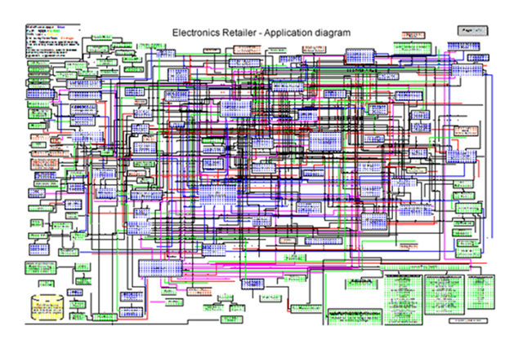

Strategy and plan – a MUST or NICE TO HAVE?

Slide 5
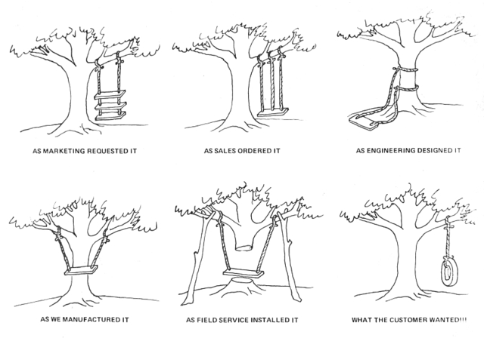

Slide 6

Building a Test strategy

Slide 7

Test strategy
A high-level description of the test levels to be performed and the testing within those levels for an organization or programme (one or more projects).

Slide 8
Elements of the strategy
Context and stakeholders
Goals and scope of testing
Test activities and work products
Additional activities related to testing
Traceability and information structure
Putting it all together – creating a strategy

Slide 9
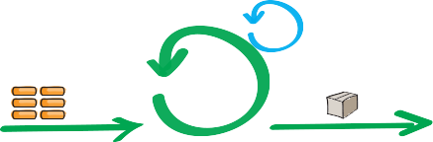





Context analysis

Slide 10

Goals
What do we test?
Why do we test?
What do we want to achieve?
How do we want to achieve it?
How to check if we met our goals?
How to improve?

Slide 11

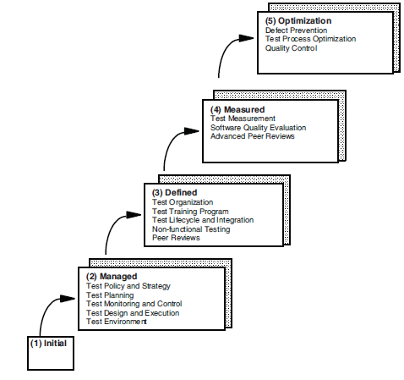
Activities
Planning, monitoring and control
Analysis
Design
Implementation
Execution
Evaluating exit criteria and reporting
Test closure activities

Slide 12

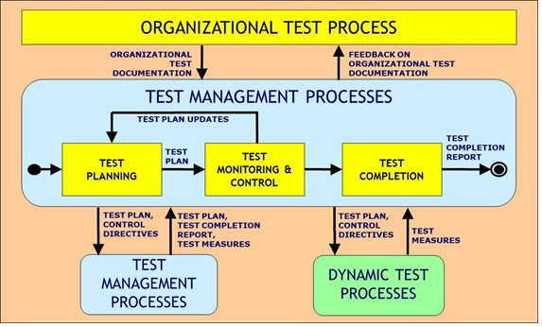
Activities
ISO 29119

Slide 13

Work products
Test strategy
Test data
Test cases
Test summary reports
Test progress reports
Risk analysis
Test plan
Test scenarios
Test scripts

Slide 14

Work products
Organization level
Test policy
Organization/
program level
Test strategy
Project level
Master test plan
Phase level
Level test plan

Slide 15
All together...
Test planning
Test Plan
Test Design Specification
Test analysis and design
Test control
Test Procedure
Test Case Specification
Test Item Transmittal Report
Test execution
Test execution
Test Log
Test Incident Report
Reporting
Evaluating exit criteria
Test Summary Report

Slide 16

Additional testing-related activities
Quality Management
Communication Management
Requirements Management
Release Planning
System Design
Risk Management

Slide 17

Traceability and information structure

Slide 18

Do you know where to look for information?
Do you know the structure of deliverables?
Do you know the source of information?

Slide 19


Information structure
What we want...
....What we get

Slide 20

Stakeholders
Business context
Business goals
Business processes
Risks
Business requirements
Acceptance criteria
Report
System requirements
UI mockups
Design
Data
Defects
Test cases
Interfaces

Slide 21
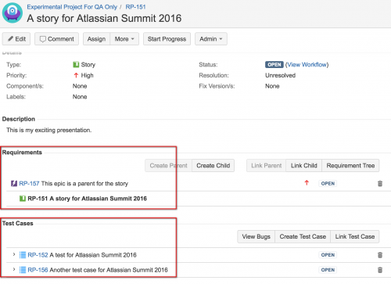
http://www.softwaretestingmagazine.com/knowledge/choosing-a-test-case-management-solution-for-jira/

Slide 22

Putting it all together...

Slide 23
Test strategy
Test strategy identifier
  1. Introduction
  2. Standards to use
  3. Risks to be addressed
  4. Levels of testing and their relationships
    4.1 Entry criteria
    4.2 Exit criteria
    4.3 Degree of independence
    4.4 Techniques to use
    4.5 Extent of reuse
    4.6 Environments
    4.7 Automation
    4.8 Measurements
    4.9 Confirmation and regression testing
    4.10 Risks
  5. Incident management
  6. Configuration management of testware
  7. Test process improvement activities
  Approvals
Test Strategy
Test automation
Test tools
Reusability of software work products and test work products
Confirmation testing (re-testing) and regression testing
Test control and reporting
Test measurements and metrics
Risk management
Defect management
Configuration management approach for testware
Roles and responsibilities

Slide 24
Test plan
Test plan IEEE 829:1998
  Test plan identifier
  Introduction
  Test items
  Features to be tested
  Features not to be tested
  Approach (activities, tools)
  Item pass/fail criteria
  Suspension/resumption requirements
  Test deliverables
  Testing tasks
  Environmental needs
  Responsibilities
  Staffing and training needs
  Schedule (test milestones and item transmittal events)
  Risk and contingencies
  Approvals
Master Test Plan
Items to be tested and not to be tested
Quality characteristics to be tested and not to be tested
Testing schedule and budget
Test execution cycles and their relationship to the software release plan
Relationships and deliverables among testing and other people or departments
Definition of what test items are in scope and out of scope for each level described
Specific entry criteria, continuation (suspension/resumption) criteria, and exit criteria for each level
Relationships among test levels
Test project risks

Slide 25


Slide 26


Slide 27

Your turn

Slide 28
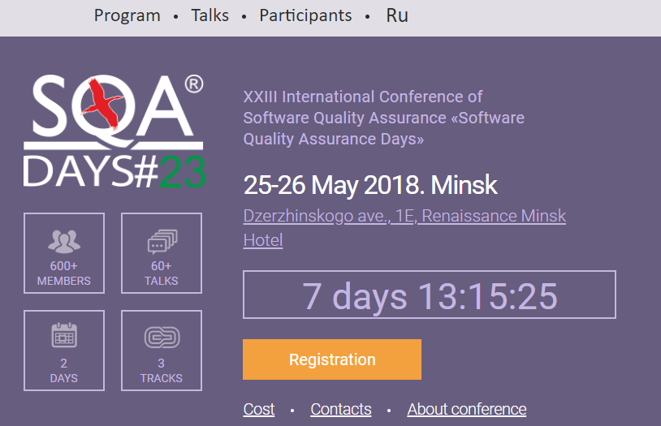
System under test
Looks familiar? ☺
https://sqadays.com/en/index

Slide 29

Summary and recommendations

Slide 30

Context
Goals
Scope
Stakeholders
Artifacts, deliverables, processes
Information structure and clarity
Good luck ☺

Slide 31


Slide 32


Raising the bar
www.testwarez.pl
14-16.11.2018
ZAKOPANE, POLAND

Slide 33
Thank you for your attention!
Stowarzyszenie Jakości Systemów Informatycznych
ul. Poznańska 16 lok. 4
00-680 Warszawa
Karolina Zmitrowicz k.zmitrowicz@sjsi.org

