Slide 1


Motivation
is bullshit.
Notes:
I would like to ask you all to stand up and stand only on your left leg.
Now, point on me your left hand.
Now with you left hand, make circles to the right direction. Like a clock.
It means to the left – difficult, right? Its because every our part of brain operates a differently and thats why its so difficult for us.
And now, Im really sorry for a dissapointment, but this task doesnt have any connection with my presentation – I just wanted to see how motivated you are to hear me talk

Slide 2

Write down:
One thing which holds you back at
your work. If you could change something (procceses, people, reward), you would love your job 100%.
Notes:
Demotivates you in your job

Slide 3

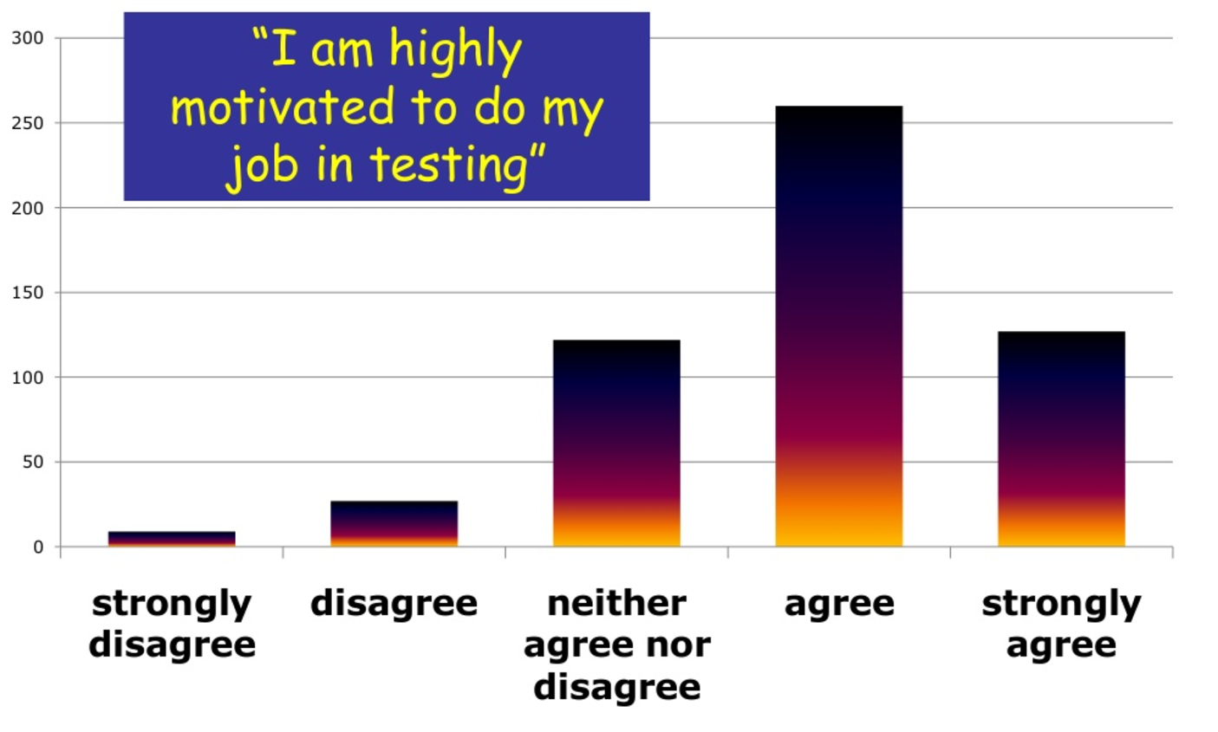
40 questions
50% V-Model, 25% Agile, 25% rest
700 participants
Here are the facts:
2 years process
Notes:
Research worldwide, the main goal of this research was to conclude if people in software testing are motivated or demotivated to do their job.
The sentence was exactly: T am highly motivated to do my job in testing. Agree or disagree.
Everything with a onr msin goal – to confirm or denied a sentence -

Slide 4

Thank You for Your attention!
Not yet!

Slide 5

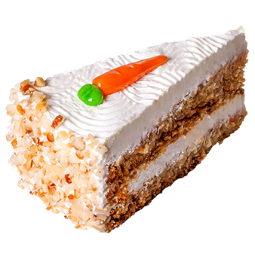
Motivational theories
Hierarchy of Needs – Maslow, 1943
Motivation-Hygiene Theory – Herzberg, 1959
Theory X vs. Theory Y – McGregor, 1960
Expectancy Theory – Vroom, 1964
Equity Theory – Adams, 1965
Job Characteristics Model (MPS) – Hackman and Odlham, 1976
Three Needs Theory – McClelland, 1988
Temporal Motivation Theory (TMT) – Steel and Konig, 2006
Motivation 3.0 (MAP) – Pink, 2010
No!
Get practical!
Notes:
Its a long long time ago when only From the time that only money – here a carrot – was the only motivation source.
Right now we are far more demanding, we want more – we want a carrot cake, with all layers, with everything what actually carrots can offer.
Or better said, if we are ok with a salary, then we want more.
There are a lot of motivational theories and I would like to focus on the most important ones.

Slide 6









Agenda
Insights Discovery
It starts with you!
Wind-Up tester
Speed problem solving
Notes:
And after we will focus on newbies, on seniors and at the very end, you will talk a lot and I will give you a solution to every your problem.
And at the end I promise you, you will leave this room with an answer to your motivational problem.

Slide 7
Get to know yourself!
100%
Thinking
100%
0
100%
Introvert
Extravert
Feeling
100%

Slide 8
Realistic
Precise
Determined
Relaxed
Cheerful
Assertive
Fun
Accurate
Caring
Well - argued
Reflective
Challenging
Enthusiastic
Accomodating
Concise
Firm
Steady
Factual
Objective
Reliable
Active
Constant
Sensitive
Cautious
Driving
Structured
Tactful
Harmonious
Convincing
Courageous
Purposeful
Strong-willed
Calculating
Formal
Mobile
Diplomatic
Logical
Sociable
Persuasive
Patient
Influencing
Forceful
Conventional
Analytical
Consistent
Outgoing
Optimistic
Decisive
Correct
Loyal
Friendly
Co-operative
Stable
Amenable
Daring
Exact
Calm
Engaging
Dynamic
Impulsive

Slide 9
Realistic
Precise
Determined
Relaxed
Cheerful
Assertive
Fun
Accurate
Caring
Well - argued
Reflective
Challenging
Enthusiastic
Accomodating
Concise
Firm
Steady
Factual
Objective
Reliable
Active
Constant
Sensitive
Cautious
Driving
Structured
Tactful
Harmonious
Convincing
Courageous
Purposeful
Strong-willed
Calculating
Formal
Mobile
Diplomatic
Logical
Sociable
Persuasive
Patient
Influencing
Forceful
Conventional
Analytical
Consistent
Outgoing
Optimistic
Decisive
Correct
Loyal
Friendly
Co-operative
Stable
Amenable
Daring
Exact
Calm
Engaging
Dynamic
Impulsive

Slide 10

Bull‘s red
Detailed blue
Cautious
Deliberate
Formal
Questioning
Precise
Competitive
Strong-willed
Purposeful
Task-focused
Goal-oriented
Harmonic green
Shiny yellow
Caring
Encouraging
Patient
Sharing
Relaxed
Sociable
Dynamic
Demonstrative
Enthusiastic
Persuasive

Slide 11
Complex work with data
Tools, tools, tools
Processes
Precise analysis
Work with the best
Determinated
Challenges
Quick and clear decisions
What do you like in your job?
Team, team, team
Challenges
It was fun
Creative tasks
Nice collective
Relationship with a boss
Everything has a time
Kind people
Notes:
HR shout and they give a list to a candidate.
No! Wait for a while and ask.
Before you start to shout at them that we have benefits – wait for while and firstly ask what did they like in their previous job.
According to their answers you can better communicate your benefits and emphasize
EMPHASIZE BENEFITS THEY REALLY WANT
We have many benefits, so you can pick from a big variety – but I guess for you could be the most interesting ….
BUT, be aware, except of some extremes – there is nothing such, in this job probably this person will be better. Everyone can be goon in everything.
Just everyone will have a different approach to solve things.

Slide 12





Cautious
Deliberate
Formal
Questioning
Precise
Aggresive
Controlling
Driving
Overbearing
Intolerant
Competitive
Strong-willed
Purposeful
Task-focused
Goal-oriented
Stuffy
Indecisive
Suspicious
Cold
Reserved
Insights Discovery
Sociable
Dynamic
Demonstrative
Enthusiastic
Persuasive
Docile
Bland
Plodding
Reliant
Stubborn
Excitable
Indiscreet
Flamboyant
Frantic
Hasty
Caring
Encouraging
Patient
Sharing
Relaxed
bouskovap@gmail.com
bouskovap
petrabouskova

Slide 13
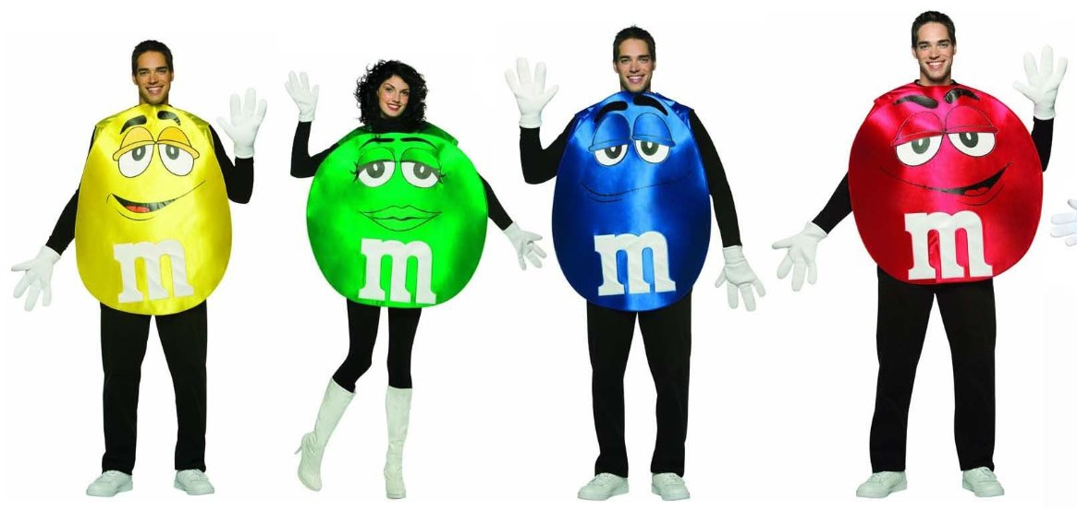
It starts with you!
Notes:
During my talk I will switch between – this is for team member, what you should do or push your test lead.
And then I will switch sometimes and say, cmon, this is for test lead, do this with your people.

Slide 14
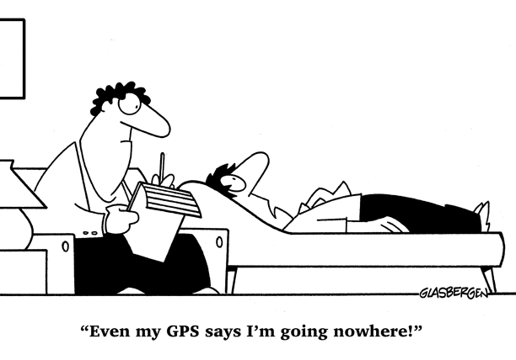





Direction matters
Depth
Breadth
Candidate on
interview

Slide 15
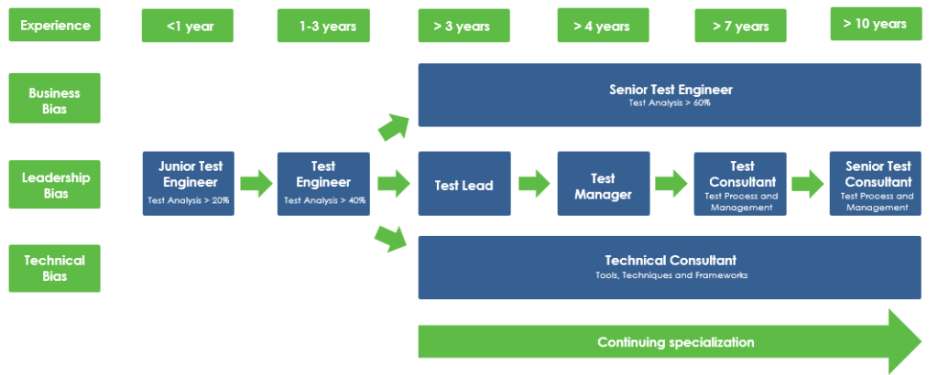
Your career path

Slide 16






We want feedback!
Notes:
If he brings a value to a society. Regular F2F meetings, once per month for one hour.
If you lead people, schedule it – if you dont have it in your calendar with your boss, schedule it, be proactive.

Slide 17

We want feedback!
Detailed info – email
Be prepared with data
Give him time to ask
Be logical
Be patient
Get to the point
Move quickly
Show clear results
Focus
Don‘t be too emotional
Nodding – agree listening
Provide support
Understand him
He doesn‘t like changes
Slow down
Keep it simple
Be aware he will talk a lot
Compliment, be positive
Focus on emotions
Challenge him

Slide 18

1. Describe situation
PIZZA feedback
8. Agreement & action!
2. Use data, facts
7. Tasks & deadlines
3. If I understand well..
6. Consequences
4. Listen and ask
5. What do you suggest?!

Slide 19

Conferences & MeetUps
Notes:
You can go and participate. Or go and speak there. This could be your new passion,

Slide 20
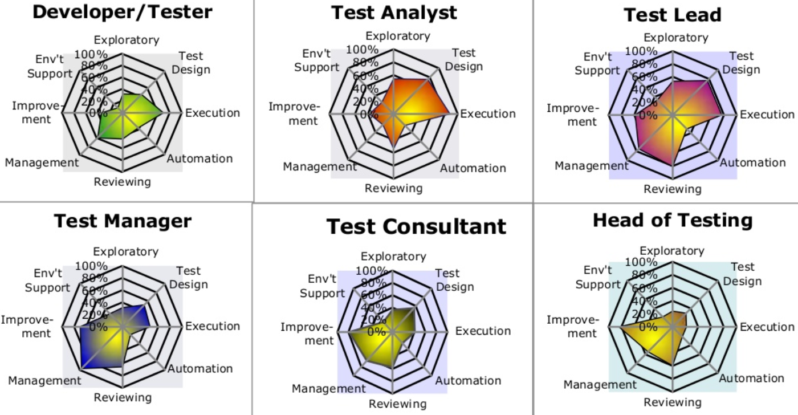
Want a specific training!
Notes:
The key message – provide people relevant trainings. Not only some trainings, but these which are highly important for them!
We dont want Micromanagers. we want people competent in their jobs and tasks.

Slide 21


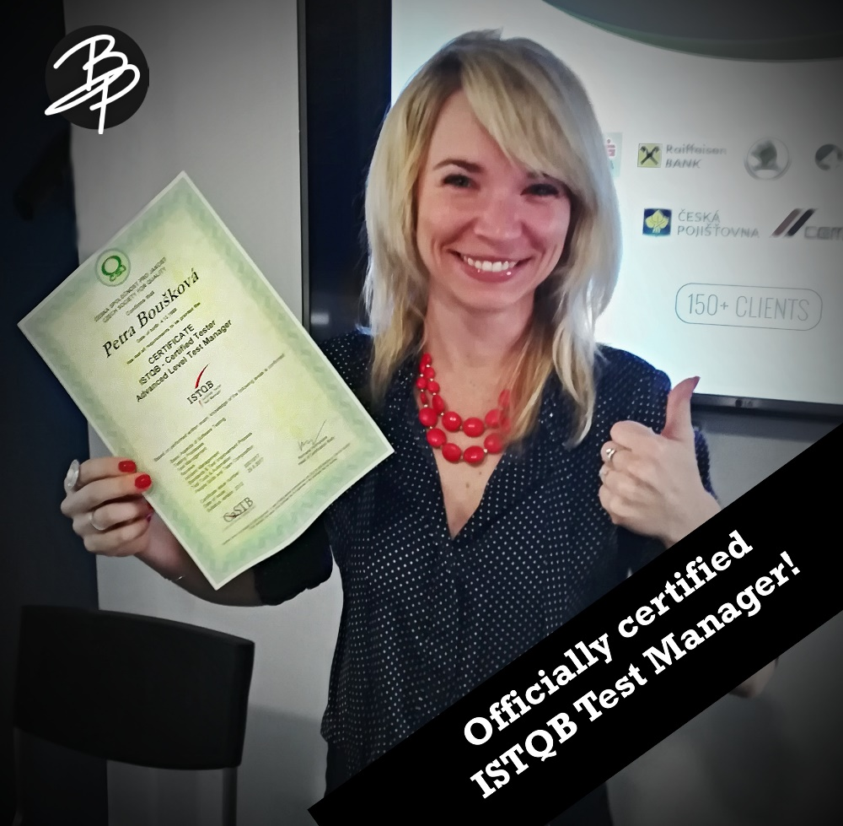
You are certified!
Notes:
Raise your hand, if you have some certification – probably the most common one is ISTQB.

Slide 22
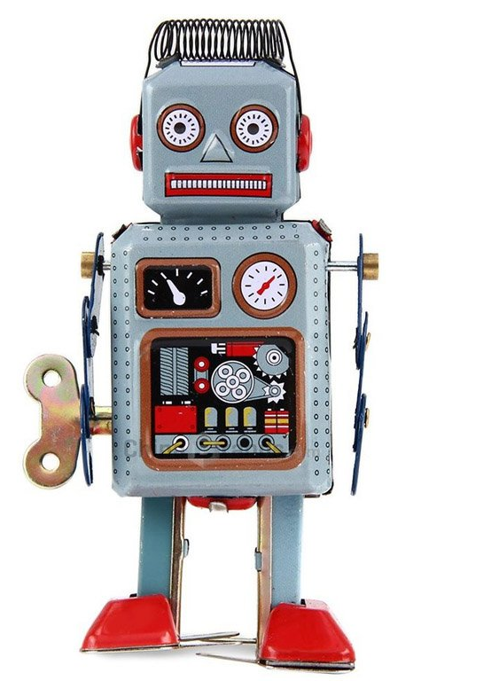
Wind-Up Worker
I am fine!
Notes:
A question for milion rubls. How to motivate a person, who doesnt want to be motivated?
Always the same question from test managers or test leads – I have had many F2F with him, I dont know what he wants, he is just fine all the fucking time.

Slide 23

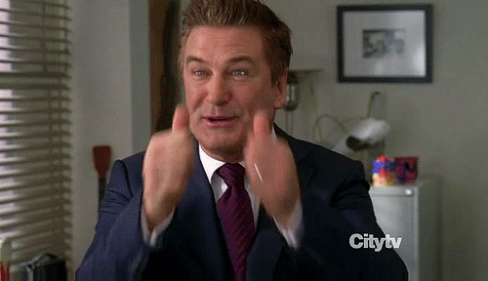
Wind-Up Worker
Noone can motivate him
Motivation
is a bullshit.
Yes? No?
if he is not willing himself.
Notes:
If you dont have inside you something what drives you ahead.
Does he deliver outcomes you want? Is he effective? No problem with him?
Then how to motivate him – fire him! It helps him, it helps a team, because afterwards you will a hero. You did it!

Slide 24



Speed problem solving
1. Create groups of 3 people.
2. Done? Please raise your hand.
3. One starts to explain his problem.
1 min
4. Two people give their advices and experiences.
2 min
5. The next one explains his problem.
1 min
. . .

Slide 25




Find your colour!

Slide 26




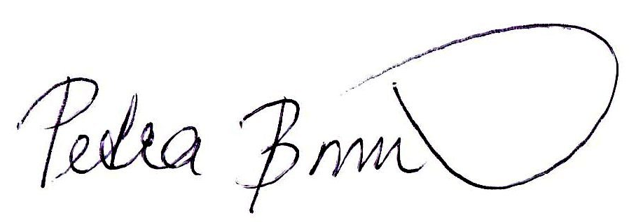
Now it‘s your turn!
Improve processes in
your job, talk to people,
take action!
petrabouskova
bouskovap
bouskovap@gmail.com
petra.bouskova
petrabouskova.com
bouskovapetra

