Slide 1

Automation in the world of projects
Zbyszek Moćkun
Clan Head / Global Head of QA Practice

Slide 2






Intro
About me

Slide 3
Agenda
01.
The world of projects
02.
Selling the test automation
03
Frameworks / Tools reusability
04.
Whole Team approach
05.
Summary

Slide 4
Intro
The world of projects
Project-based company
Mostly Web, where the center of the galaxy are Content Management Systems (CMS)
Delivered by Adobe or Sitecore
Which are Customizable
And Integrated with everything
  (even black hole)

Slide 5
Selling the test automation

Slide 6
Selling the test automation
When ROI doesn’t work anymore
ROI
Return of Investment

Slide 7
Selling the test automation
The coverage
Code coverage
TestCase coverage
Requirement coverage
Feature coverage
10%, 20% ... 50%, 80% ?

Slide 8
Selling the test automation
Does
TEST AUTOMATION
bring
BUSINESS VALUE?

Slide 9
Selling the test automation
Business Values
Delivery Approach
  Number of releases
  Continuous Delivery
  Should release be production ready?
Time to release
  SLA defects
  Lead time (time to deliver new feature)

Slide 10
Selling the test automation
Business Values
Extendability & Maintainability
  Is it one-off or continuous improvement
  Decision determines futher costs
Business critical areas
  Business logic
  Technical and business risks
Other client’s challenges
  A/B testing
  Make application authorable than require code change

Slide 11
Selling the test automation
Test Automation
DOES NOT
bring
business value.

Slide 12
Be the expert!
Propose solution for challenges
Test automation is not always the answer

Slide 13
Selling the test automation
Do not ask questions such as:
Do you need test automation?
What test automation coverage do you need?
Or suggest test automation as a remedy for all quality or delivery issues.

Slide 14
Frameworks / Tools reusability
across the projects

Slide 15
Frameworks / Tools reusability
The advantages of reusability
Cheaper
Faster
Ready and existing infrastructure
Teams are familiar with the tools
Tools are specialized

Slide 16
Frameworks / Tools reusability
Client’s concerns
Client is the owner of the code
  reuse the internal framework and give it away
List of approved tools / frameworks
  Your internal frameworks are not listed
If you use internal framework
  Do you share the code with us?
Who covers the maintenance costs?
  How do you ensure us that we will not be in the position to get rid of your frameworks?

Slide 17
How much our internal IPs are worth?
Can we get additional money from internal tools?
Cognifide’s business side

Slide 18
Frameworks / Tools reusability
The results
Test automation starts very late or at the end of the project
We produce a lot of technical debt and its elimination costs us a lot more

Slide 19
Frameworks / Tools reusability
Let’s OPENSOURCE

Slide 20
Client’s concerns - solved
٦٦
Client is the owner of the code – reuse the internal framework and give it away
٦٦
List of approved tools / frameworks – your internal frameworks are not listed
٦٦
If you use internal framework – do you share the code with us?
٦٦
Who covers the maintenance costs? How do you ensure us that we will not be in the position to get rid of your frameworks?

Slide 21
Framework / Tools reusability
Common benefits
People are proud
We (people and the company) are recognized as experts
Company values
  Knowledge sharing
  Building a community

Slide 22
Frameworks / Tools reusability
The unexpected reward
Bigger project scope
=
More money

Slide 23
Framework / Tools reusability
Bigger project = more money
We sell automation
We train the client’s team
We build the test automation infrastructure as a part of the project
We maintain the test automation infrastructure too

Slide 24
Automation as whole team approach

Slide 25


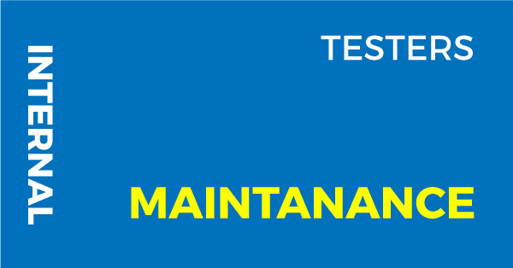

Automation as whole team approach
The old way
Automation Responsibility Square –Testing Experience , June 2011

Slide 26
Automation as whole team approach
What has changed
Improved quality of features delivered by devs
Developers interested in automation
Automation as part of application code
DoD – Delivered and Maintainable
Switch from Testing to Quality Assurance
Better understanding of Test Pyramid
Continuous Delivery

Slide 27
Automation as whole team approach
The old way
Automation Responsibility Square –Testing Experience , June 2011

Slide 28

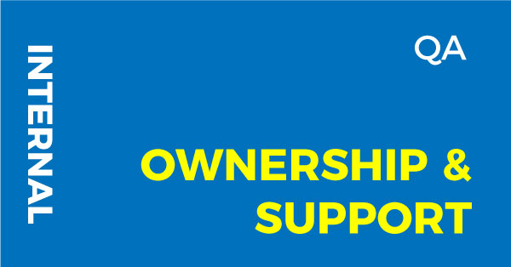

Automation as whole team approach
The new way
Automation Responsibility Square – April 2018

Slide 29
Automation as whole team approach
How it works?
QA as the owner
Test automation training for dev at the beginning of projects
DoR – what we want to automate
Two-side Dev<->QA code reviews
QA Demo – automation as part of the demo
DoD – Delivered and Maintainable
Automation as a part of the backlog and technical debt (assign tasks for next sprint)

Slide 30
Key takeaways
01.
Test automation is not a business value
02.
Open source open doors
03.
Move automation from tester to whole team

Slide 31
Thank you

